Slide 1

EMPOWERING DEAF PEOPLE THROUGH TECHNOLOGY
Notes:
Hello everyone and nice to meet you all, I’m Michael where I’ve worked for Microlink for over 20 years now as an Assistive technology Consultant carrying out researching, advising and supporting people across a broad range of disabilities or conditions with a heavy focus on being a hearing specialist. That involved carrying out assessments for people with hearing loss, finding solutions to overcome their barriers, in work or education environment then do the setup and training, don’t do it has much now as we’ve got a team of people we’ve taught over the years to carry out these roles. Also I’m profoundly Deaf myself and use tools to help me overcome my communication barriers such as wearing a hearing device called a Cochlear Implant and using wireless technology to communicate as well as captioning, yes I can do a little bit of sign language too so I’ll be able to relate to some of what we’re going to talk about in this session.

Slide 2
Overview of Todays Topic
INTRODUCTION
Solutions to support people with hearing loss to communicate independently in any environmental setting.
Awareness – Hearing loss and communication tips
Business solution – Accessibility for hearing loss
Individual Solutions – Overcoming barriers
Notes:
Just to briefly highlight the topic’s I’ll be covering in this webinar today which is about supporting people with hearing loss to communicate independently in any environmental setting. I’ll briefly give you snippets of deaf awareness we cover and about how to look after your hearing. Provide an overview of solutions for businesses to minimise the impact for employees when working or customers accessing your services. Then we will finish off with technological solutions for individuals that wants to overcome communication barriers.

Slide 3

Deaf awareness
AWARENESS
Deaf Awareness
A Short session on deaf awareness
Identifying a person with hearing loss
Factors on hearing loss
Loss of high frequency sounds
Notes:
over the years we've provided deaf awareness session for clients who have colleagues that are deaf or dealing with customers that have some form of hearing loss. so I thought I’ll do a short session to give you an overview.
one of the first question on most people mind is how do you know if that person is deaf or have a hearing loss? deafness is an invisible condition isn't it? that is something i would talk through, how to identify a person who is deaf, one sample is they might not be able to hear from behind,, saying excuse me on the escalator to walk by and not making way, blocking the door way to let you by or like asking to hold lift door but didn't
someone might have reacted while another person didn't, why is that? because there are different levels of deafness. someone might only have high frequency hearing loss, unable to hear fire alarm or telephone ringing well, if these are high pitch. someone with moderate hearing loss might hear the phone and alarm while struggle with listening in a conversation with misheard words containing 'f' 's' 'th' like saying "are you thirsty" cos they probably wouldn’t hear the word thirsty as many of these letter contain high frequencies and will get lost in the conversation when saying “do you need a drink” as there are fewer words that start with Drin… giving that person a high chance of being understood.
Next slide, here is a sample ………

Slide 4
High frequency hearing loss
AWARENESS
Mic_ael’_ main area of ex_erti_e is in __e _earing loss _ector, a_ _e i_ dea_ _im_el_. _e _u__ort_ a__e__or_ in _inding __e right _olution_ to reduce communication barrier_ _or people w_o are Dea_ or w_o _ave _earing lo__, a_ well a_ carrying out a__e__ment_ _im_el_ in bo__ __e wor__lace and educational _acilitie_.
Notes:
Heres a sample of what it like to have high frequency of hearing loss, Imagine having a book with every S, F, Th, Sh, Ch, K, P and H erased. You could read part of the book and understand some of it, but you would not be able to understand many key words and phrases and, as a result, be challenged to understand it. This is what is happening with a high frequency hearing loss. You can hear part of the message, however your high frequency loss has “erased” the key sounds or letters needed for discrimination and understanding.
Michael's main area of expertise is in the hearing loss sector, as he is deaf himself. He supports assessors in finding the right solutions to reduce communication barriers for people who are Deaf or who have hearing loss, as well as carrying out assessments himself in both the workplace and educational facilities.

Slide 5
A short session on deaf awareness
AWARENESS
Deaf Awareness
A Short session on deaf awareness
What does Deaf mean?
Why do Deaf communicate in BSL?
Notes:
what does Deaf mean? Is it someone who unable to hear or partially unable to hear? that ‘s the term in the dictionary, so it not clearly defined for those with hearing loss. Not everyone likes to be labelled Deaf, from experience most people would be happy with saying "have a hearing loss" which would come under the term of hard of hearing “not able to hear well” meaning born with hearing loss or later in life where they have trouble fully understanding what is being heard. While Deaf is identified with someone who are most likely born with no hearing or loss their hearing as an infant. the capital ‘D’ is usually recognised as part of a culture identity within the Deaf community, they mostly use sign language to communicate and take pride in their visual language with little or no access to English and do not wear hearing aids.
BSL is British Sign Language, in short This is a language in its own right with grammar structure, syntax and words that is not related to spoken/written language therefore not following the same structural sentences of English because how do you communicate if you're unable to hear?
To show you want I mean,

Slide 6
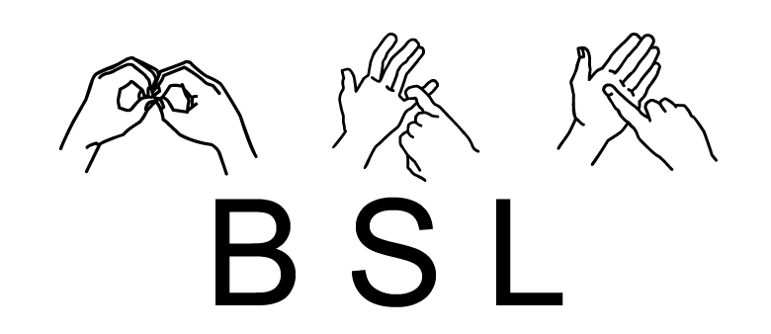
British Sign Language - Structure
AWARENESS
Deaf Awareness
British Sign Language - Structure
First sample
  Why was the black cat climbing the tree in your garden yesterday?
  Yesterday your garden tree black cat climb why?
Second sample
  My Grandma is from France but my Grandad is from Canada and they met in Paris.
  My Grandma from where? France. My Grandad from where? Canada. Both meet where? Paris.
Notes:
This is a sample of British sign language structure and what it would look like from English to BSL.
As you can see in the first sample, “Why was the black cat climbing the tree in your garden yesterday?” Which is what we normally say, however in sign language using hand and body language with factual expression this would be “Yesterday your garden tree black cat climb why?”. As you can see the Why statement is at the end of the sign language communication.
Here is another sample, “My Grandma is from France, but my Grandad is from Canada, and they met in Paris.” in spoken English and this one would be signed in BSL as “My Grandma from where? France. My Grandad from where? Canada. Both meet where? Paris.” I hope that give you some idea how Deaf people communicate in sign language.

Slide 7
Communication strategies
AWARENESS
Deaf Awareness
Communication strategies
Mute microphone in conference calls
One person speaks at a time
Ensure room/area has good lighting
Notes:
Before giving a couple of samples for communication strategies, the sound of your voice signals the start of an interaction. However, if someone is reliant on facial expressions and lipreading to communicate or mishear, they will be on the back footing and when they turn around you’re already in mid-sentence. So it good practise to have their attention before engaging. You might be wondering how do I do that?, ask them, we’re all different, some don’t mind being tap on shoulder or have hand wave in front of them. I like people knocking on the desk to get my attention as it a low heavy tone and loud, and I can feel it too and it doesn’t make me jump when you’re seeking up behind me ;-)
Muting the mic during conference calls helps to remove unwanted background noise because someone with hearing difficulties, especially with hearing aids, can’t discriminate speech from noise and will completely mishear lots of words. I’ve heard dogs barking, people drinking, eating food or typing away on keyboard and that muffs the speech which can be frustrating for those that trying to listen.
We all like to talk in groups, whether that meeting in the office or on conference call, it helps in one person is speaking at a time to avoid overlapping. This can also help make sure captions are more accurate or interpreters when signing to the Deaf person/people if they are used.
During video conference call, meeting in office or having a conversation in person ensure the room has good lighting, with no faces in shadow – poor lit rooms or light bulb behind would cause people to struggle when trying to lipread as well as trying to listen. It’s the same with sunlight too
There is so much to cover on Deaf Awareness, such as lipreading, tinnitus, role of interpreters, how technology benefit people with hearing loss and condition related hearing loss like Manière's diseases. These session can be tailored around the employee who is deaf cos not everyone use sign language or born with a hearing loss but happened suddenly, therefore everyone has different level of communication skills and how it can impact their wellbeing because most people don’t know what it feel like without asking or having a deaf awareness session.

Slide 8
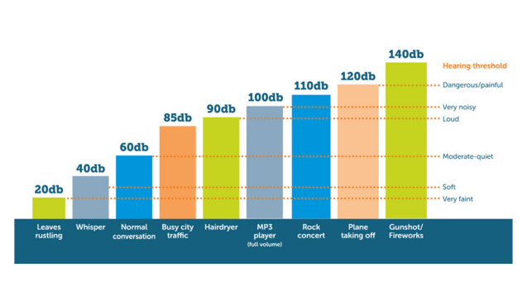
Looking after your hearing
AWARENESS
Hearing Care
Looking after your hearing
Noisy environment
Sound exposure
Decibel threshold
How to care for your hearing?
Notes:
Thought be good to touch on the hearing care a little bit because we do live in a very noisy environment now compare to 20 years ago, hardly anybody was using mobile phones or listening to music via headphones or earphones and today we’re consistently hearing everything, music, TV, Traffic, shopping centre, coffee shops, factory floors, call centres.
we’re all exposed to sound from everywhere and you might think or say, “oh my hearing is fine”, but what about in 15-20 years time? It’s been known that as you get older people start to lose some of their hearing, a lot of this is age related, however there are job roles out there that could have a potential impact and how much sound exposure people experience each day over the years, such as machines in the factories, bartenders or flight crews but they would usually have some form of ear protection. Like when going to music festivals, you would wear ear plugs would you?
Government research has suggested that 85 decibels is the threshold limit when exposed to sound/noise for up to 8 hours a day and for every additional 3dB increase, sound levels double. So for example, if you were listening to phone calls, music or were in a noisy environment that was registering sound output at 88dB, then that exposure would be reduced to 4 hours a day.

Slide 9
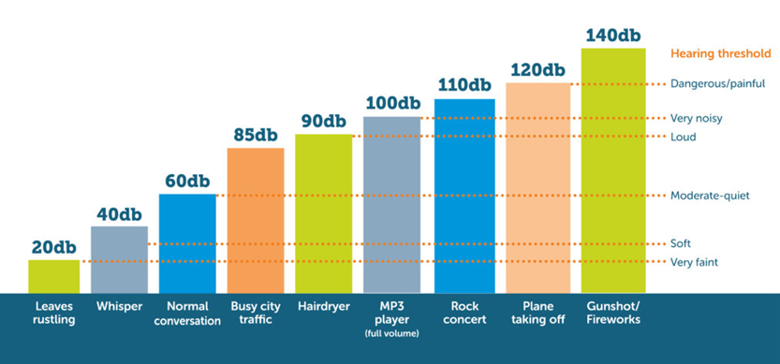
Decibel chart
Notes:
I’m conscious of time, so I’ll be very brief on this chart here, you can see normal conversation in quiet room is around 60db but if you went to a rock concert with sound output registered at 110db, it is important to note that most people would be wearing earplugs because without them your ears can only handle this level of noise for less than 2 minutes. Music is the second biggest cause of hearing loss, while aging is top of the list, this is known as noise induced hearing loss and you wouldn’t know the affects until years later.

Slide 10
Hearing care
AWARENESS
Hearing Care
Looking after your hearing
Noisy environment
Sound exposure
Decibel threshold
How to care for your hearing?
Notes:
How do you care for your hearing then? I would look at the Volume controls as they’re regulated by yourselves by checking volume is set at a natural level, as a guideline this is usually at around 50 to 60% of the maximum volume, for example max value is 10 or 100, set it at 5/6 or 50/60 because exceeding that would be too much for your ears.
That was a sample overview on how to look after your hearing in work and personal life too as people might not realise until it to late and it can have an impact on their wellbeing.

Slide 11
Accessibility for hearing loss
BUSINESS SOLUTION
Solutions to make premises accessible for people
with hearing loss.
Counters and Kiosk
Reception areas
Auditorium
Making content accessible
Notes:
As I mentioned in the deaf awareness, hearing aids pick up noise and speech equally, for example you’re at a kiosk to purchase some tickets with the environment being noisy, how do they hear you? in reception, people walking on hard wearing floors, in the auditorium someone eating crisp or slipping a drink. These scenarios can muff the speech, therefore missing words so we have to repeat what we’ve just said, that okay in kiosk, counters and receptions but can’t really do that in auditorium can you and you didn’t hear the joke while the audience are laughing. also, they might be discreet about their hearing loss? you all know subtilties are available for people with hearing loss on TV at home, it’s on the news, films and programmes. Not everyone has their videos create with caption/subtitles and what about those people who can’t hear at all and how do they get in touch with you? particularly those that sign in BSL as their first language. Do we want them to have their independence?
I’ll be covering some possible solutions to make your premises and services a accessible for clients, visitors, public on the next couple of slides before we discuss individual solutions.

Slide 12

Induction Loop systems
BUSINESS SOLUTION
Solutions to make premises accessible for people
with hearing loss.
Counter loops
Large area loops
Portable loops
Non wired loop solutions
Site surveys and/or inspections
Notes:
You’ve all seen these logos everywhere in shops, banks and cinemas, mostly where public would visit, this allows people with hearing aids to turn on their telecoil option, known as a ‘T’ switch, that detect the magnetic field from the loop which is a wire that’s hidden and connected to amplifier linking to an audio source or microphone. This helps to improve the clarity of speech with minimal background noise and it been around for a long time due to them being effective and reliable.
Some solutions are counter loops for reception area that can be installed under the desk or counters with a desk microphone that are usually straight forward and easy to install.
Large area loops are designed for meeting rooms or auditoriums, you don’t need to have induction loop system in all the meeting rooms, maybe just the one room so it accessible for visitors attending those meetings? This solution works differently to the counter loops as it would use copper tape as a induction wire/loop that fit under carpet around the room and rather than using standard microphones we can use boundary microphones to pick speech in close proximity. In auditoriums for staff or audience for theatres, TV shows, the amplifiers would be connected to the AV systems.
Portable loop systems can be used in receptions or meeting rooms although checking and setting up before use. They come in two flavours a small portable style with a handle that sit on a table/counter or in a kit that got wires to put around the room linking to the amplifier and microphone, idea for those that set up events around the country.
What about non-wired solutions, you can use radio frequency with a portable neckloop device receiving the signals from AV systems with a compatible transmitter system, these neckloop device is a little box with a wire around the neck that send a signal to the hearing aids, it more design for auditoriums so you don’t have to do wiring under the floor, however it won’t be as discreet and not everyone might ask for the portable neckloop. Also the portable loops have audio jacks for headphones for non hearing aid users.
Usually site surveys are carried out at the premise with assessment report provided on the recommended solution from that visit, especially for auditoriums. This ensure the wiring can get a signal to those hearing aids but if you’re too far away from the signal it become poor and that can be fixed by implementing a phase array wiring system to keep the signal even all around the room.

Slide 13
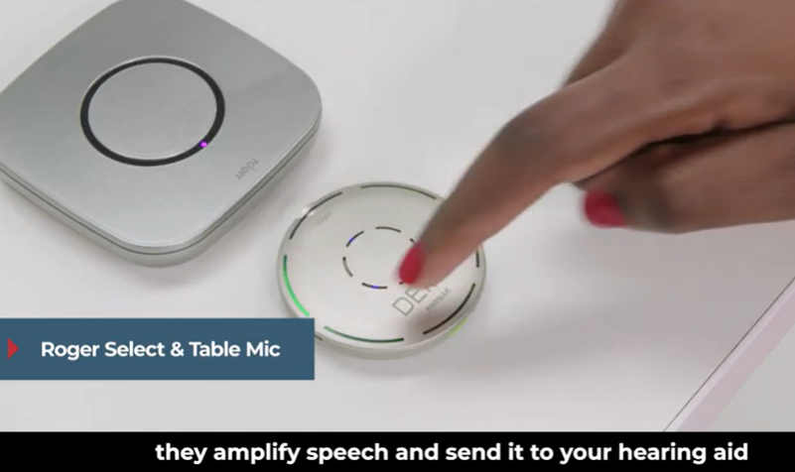
Captioning/Subtitles
BUSINESS SOLUTION
Do you want your clients, customers and viewers to be able to hear?
Overlay caption
Webinars
Kiosk and Booths
Videos
Notes:
What about those that can’t hear well, even with hearings aids or don’t wear hearing aids? because induction loop systems don’t work for everyone, as explained earlier, with a wide degree of hearing loss.
Therefore, have you ever though about using automatic caption that can be used for conferences, receptions, theatres and events? With the rights tools, setup and a good reliable internet connect it possible.
For example, you’re doing a presentation in a meeting and someone might not hear you with clarity, a solution is to use a transparent overlay to caption live what you’re saying to them, the benefit is seeing the subtitles on the same screen as the slides rather than a second screen and being able to better comprehend what you’re saying.
In webinars, like this session we’re having now that can provide captioning and BSL interpreters making yourself or company more accessible to a wider audience.
What can you do in kiosk or booths, you can use wireless ubiduo’s as a face to face communicator solution which I’ll talk about in another slide. Alternative solutions, is to have tablets with automatic caption setup to transcribe for people to fully comprehend what you’re saying because in noisy environments it can difficult to hear. What about tannoy announcements? Which I’m sure it possible if they’re all interlink with computer systems.
Do your videos on companies websites have subtitles? If not then you’re turning away thousands of viewer with hearing loss as they’re unable to view those video. Yes, you might think they’re expensive to get the entire video content done, that not the case anymore. there are software platforms that can automatically create the subtitles for you and you only need a human person to proof read them to edit any possible errors as you watch the video.
It possible to add BSL interpreters to your videos too.

Slide 14
Human support for Deaf
BUSINESS SOLUTION
Communication support making companies accessible to audiences or for individual employees.
Stenographers
BSL Interpreters
Access To Work
Onsite or Remote
Events
Notes:
Just to follow up on providing automatic captioning or subtitles, occasionally you might want to use Stenographers, they’re speech to text reporters using special phonic keyboards, look like a small panino, that joins up the phonics to create the words that appears on screen, very useful for situations where you might not be able to use automatic captioning like teleconference calls or office meetings. I use this service from time to time for when I struggle with strong or heavy accents in conference calls that can’t use support automatic captioning and maybe large group meetings so I don’t miss out on vocabularies I’m not familiar with.
As explained in a earlier slide, BSL uses different English structure, therefore, BSL interpreters are provided for those that communicate in BSL as their primary form of communication. Not everyone can sign fully in BSL as it take years to learn, train and it’s a very technical job which is why clients hirer BSL interpreter who role is to translate so they are able to comprehend from the person who is speaking, like what you’re seeing on the screen now.
I use ATW funds to support my communication needed for work, just like a lot of other deaf people who applies for communication support too and these communication support can be onsite or remote. It’s down the user preference but just be aware, on site will cost more. On the next slide I’ll talk about a new business model for having remote BSL interpreters and remote captioning.
Lots of people host events for clients or audience, like exhibitions, product launches or just seminars, and does your company make communication accessible to those with hearing loss? another reason why interpreters and/or captioners are hired to communicate in alternative format. Automatic captioning can be used in these situations too with the right setup and tools to do the job, it been done before and works very well.

Slide 15

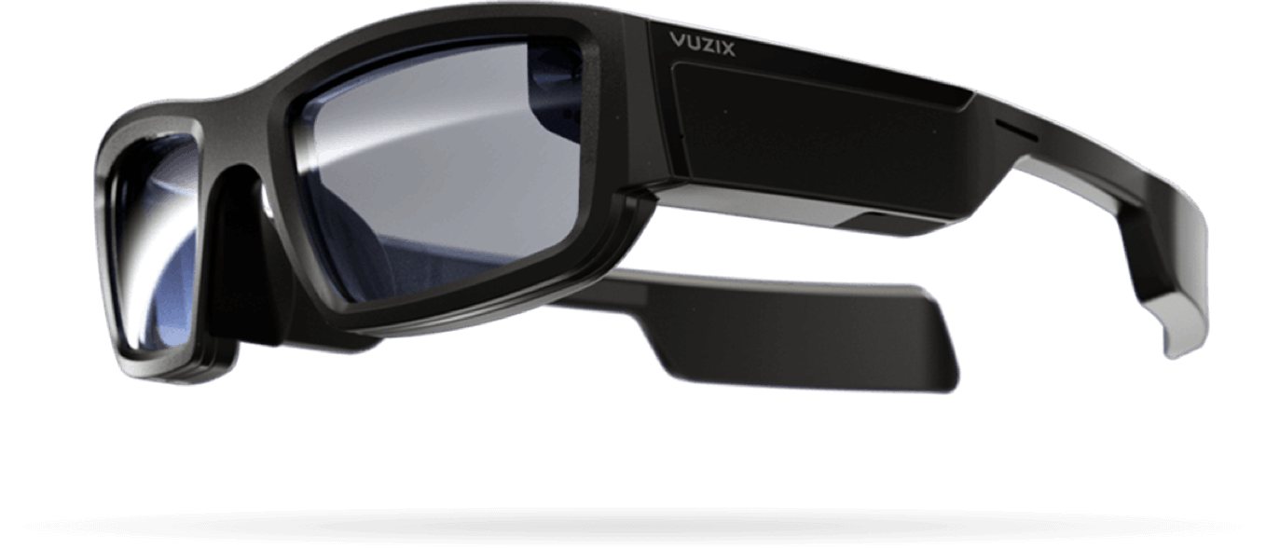
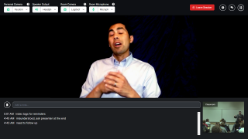
LIVE SIGN LANGUAGE INTERPRETING
SignGlasses
Having all your interpreting needs in one place.
Access interpreters from anywhere to match requirements
No need for interpreters to travel
Review recorded sign lectures or meetings
Add notes or bookmarks to make it searchable
Advance wearable glasses overlaid in the room
Remote Captioning
Notes:
SignGlasses is a booking and remote service platform for clients who need remote interpreters or captioning for training, lectures and seminars. This all works over the internet and clients can make appointments requests themselves via the user portal and it possible to request specific interpreters. Then admin will then check interpreters availability and confirm the booking for you. When the day come to use this interpreter for your session, login near the time, go to calendar and click start session, it that easy. No need for those emails communication, sharing links and making sure interpreter is seen in Zoom, Teams, etc… even the billing system is on that platform, on the admin portal. So why this solution? For a start you have all your interpreting needs in one place, no need to find your emails, look at the outlook calendar, hence streamlining the service to create a more friendly user experience.
Interpreters are available from anywhere in the UK so you’re not restricted to your geographic area, want to use a Danish or German sign language interpreter, it possible if we can source them and meets the technical requirements. Not all interpreters can cover every topic, so we could try get one that matches or close to your needs and no need for them to travel.
Some useful features to mention here, these sessions are recorded for review and you can add notes or bookmarks to make it searchable for future references, such as prepare yourself for a test or exams, sound good huh!! Cos it give you complete independences and flexibility.
The person who speaking would need a wireless microphone for interpreter to hear with clarity. It useful to have a second webcam pointing at the front to caption the powerpoint slides or whatever is on display behind the presenter or speaker.
The additional unique feature about this service is wearable smart glasses where you can have the live sign language interpreting overlaid on top of the lecture room or office environment through the lenses. The benefit is you don’t have to look at the tablet all the time to allow you to write notes to engage independent learning. Also, It could even be use for training to be a plumber, mechanic or field engineer, etc… the possibilities are endless.
The SignGlasses can be use for remote captioning too.

Slide 16

Recording of signed lecture

Slide 17
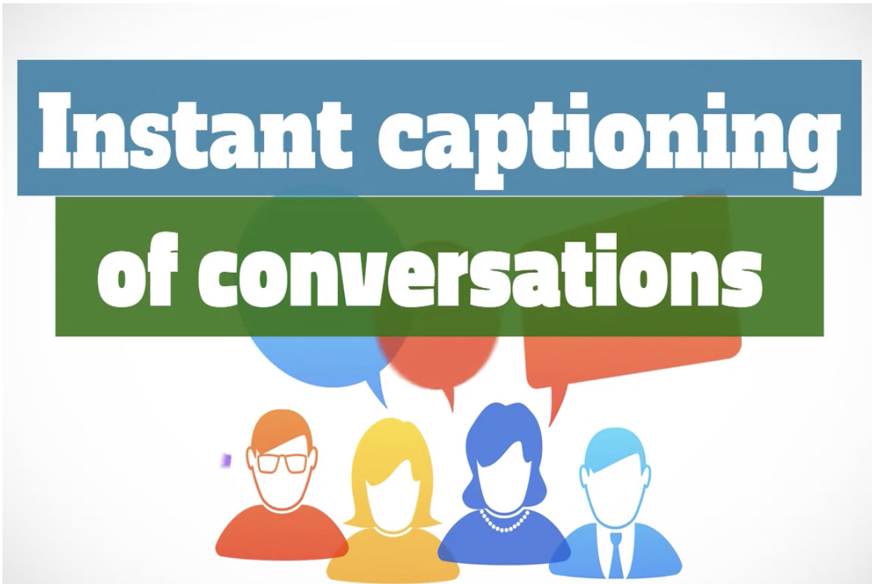
STREAMER
Communication Tools
An automatic speech to text service that’s available on-demand, anytime and anywhere?
Easy to get started
Private secure room and fully encrypted
Stream directly to almost any device
Supports multi language translation
Download or clear transcript after session
Drag and drop documents to share
Additional software tools
Notes:
you're in a video conference call, or voice only conference call and struggling to listen or unable to focus on the conversation only wishing you can view subtitles like you do on TV at home. there’s few solution to help you overcome those barriers, one sample is Microsoft Teams that has built in which works well and accuracies depend on clarity of speech and vocabularies used, also you're unable to save the transcript as notes for review.
what about other video conferencing software, do they support automatic captioning? I know Zoom doesn’t as I’m here now using a 3rd party captioning platform called verbit which is a hybrid solution that uses voice recognition to produce captioning automatically and there is someone monitoring the accuracies behind the scene who will type the corrections to achieve 99% accuracy rate as long they can heard me with clarity.
That’s just one possible solution of many, this one here is streamer which instantly produces spoken words in Real-Time on a compatible web-browser for those who struggle with listening comprehension. once setup, Its easy to use with private secure room that fully encrypts the data between computer and server that can be streamed to almost any device. There is support for multi language translation for those that wants to read in their own naïve language. there some features, such as, download or clear the transcript after session, drag drop documents to share and tag the transcript like index marker to highlight important notes to review later on as a alternative solution to taking notes.
There are a couple of tools, a transparent overlay for presentations as mentioned in the previous slide, the other software tool is CaptionAll which is due to be released soon that‘ll caption speech from multiple audio sources as if you were hearing this from the computer speaker, headset or headphones.
There is a lot of flexibility, no booking is required, it’s a monthly subscription and as it can cover a lot of your needs such as one-on-one, lectures, online learning/training, remote working, watch videos and listening to audio files and webinars is possible too, not tried music. Allowing you to manage your own resources independently.

Slide 18
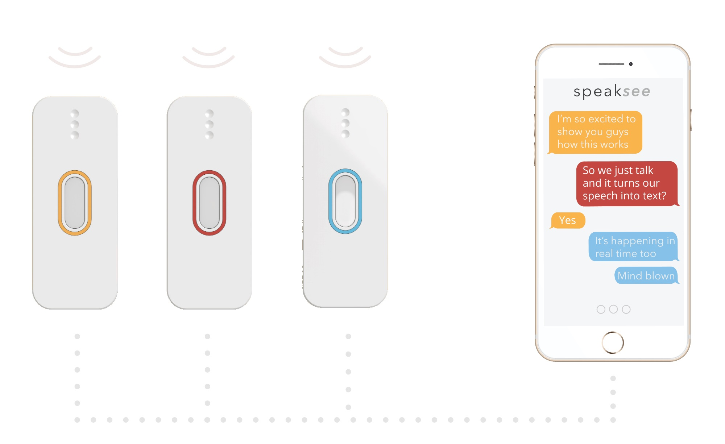
MAKING CONVERSATION MORE ACCESSIBLE
Communication Tools
Captures speech in conversations that transcribed into text on a smart device.
Microphones intelligently filters speech in noise
Works on multiple devices
Identify each speaker shown in different colours
Engage in social conversations
Capture lectures, face to face or small group meetings
Notes:
Another captioning solution call speakSee which is due to be released in the next couple of months and I just want to get it out there which can be useful for those in meeting rooms, while streamer can do that however this involves lot of hardware, tablets and microphones for each person. Here simpler solution, get your team to wear microphones as a lapel which intelligently filters speech in noise that allows you to capture conversations which get transcribed into text on either the smartphone, tablet or laptops. How it works, each speaker has unique identification shown in different colours that matches the colour of the mics and it’ll instantly produce the bubble speeches as you’re talking, a bit like those text messages in whatsapp, but using the developer own software solution. This can be useful for engaging in social conversations, use in lectures, face to face or small group meetings to improve your listening comprehension.

Slide 19
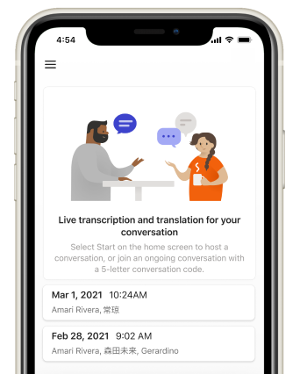
Microsoft group transcribe
Smart Phone Apps
MICROSOFT GROUP TRANSCRIBE
Group Transcribe provides real-time transcription and translation for in-person meetings and conversations.
Start a conversation from your phone
Stay focused without taking notes
Follow the conversation in real-time in your preferred language
Save, browse and share the transcript after each session
Supports languages in 80+ locales
Currently only works on iOS devices
Notes:
The Microsoft group transcribe is similar to Speak See solution I just talked about, this live transcription app enables people who are deaf, hard of hearing, and non-native speakers to participate in conversations in real time. Just click start button in the app and it’ll start transcribing, if the other person has an iPhone they too can join in the Group Transcribe app so they can read from a distance. This allows you to be more present and focused in conversations with the confidence of a high quality transcript. The conversation appears instantly on the screen and you can select your own naïve language as it supports 80+ distinct locales. The transcripts are automatically saved that can be reviewed at a later time and shared with other people who were not in attendance. Please note, this app currently only works on iOS devices with a internet connection and you all have to have your own iOS device to identify the individual people.
Google has one for their Android system called live transcribe but doesn’t allow for group sharing as it been designed for individual use. Will discuss this one at the end if we have time. Also both of these app are free to use, no restrictions

Slide 20
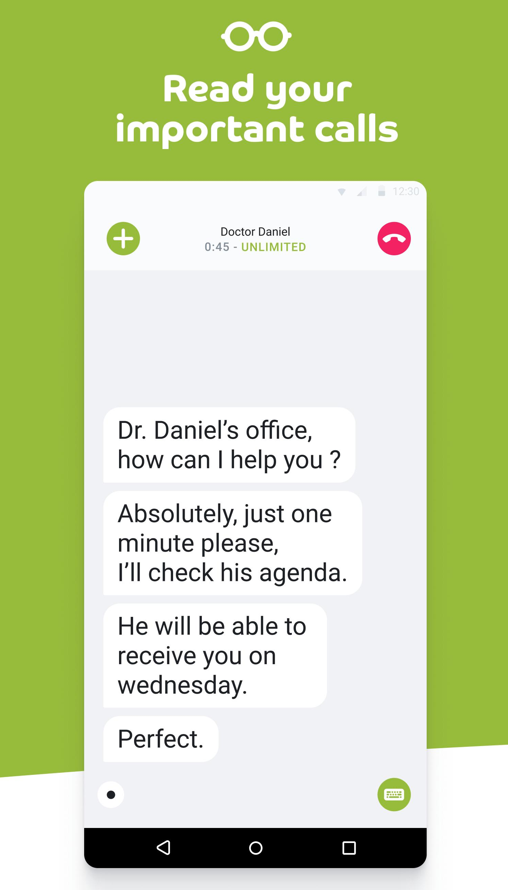
Phonak my call to text
Smart Phone Apps
PHONAK MYCALL TO TEXT
The Phonak myCall-to-Text app allows you to read, in real time, what the person on the other end of the phone says.
Live transcription of phone calls in more than 80 languages
The other person can use any type of phone (mobile, office or fixed line) and does not need to install the app
App to App calling is free
Works on iOS and Android phones
Save the transcription for later review
Notes:
The last piece of captioning software I wanted to talk about is an app for making live phone calls that produce caption while you’re talking which is live, it could be used by the managers or team leaders that are responsible for their employees to keep in touch. For example, employee is an field engineer or works in the courier service and if you both had the app, it make things easier to get in touch with each other to check in or talk about a technical issue or access to a road being block off, I’m sure you get the idea now. You can manually type what you’re saying instead of speaking too. I’ll highlight the features for this app, cos you can read the caption in your own naïve language as it support more than 80 languages. It possible to use any type of phone and don’t need to install app, that’s a paid for version but app to app is calling is free and works on iOS and android phones. Transcript can be saved for review and it’ll need internet access.

Slide 21
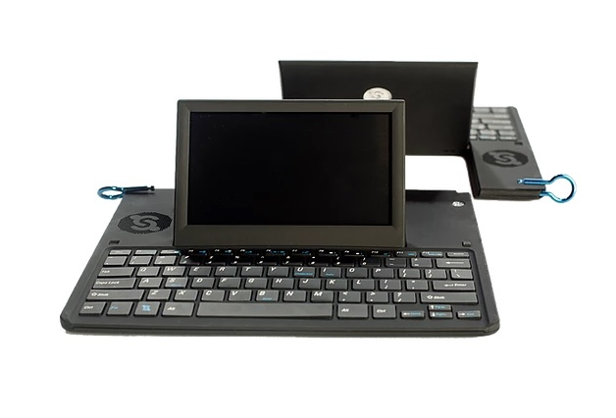
FACE TO FACE COMMUNICATOR
UbiDuo
Barrier free communication that bridges the gap between Deaf, Hard of Hearing and hearing individuals.
Lightweight, portable device
Instant Real-Time communication
Gives you personal independence
Use own secure wireless network
A full-size ergonomic Keyboard and tilting screen
Optional Speech Generating Device (SGD) for speech impairment
Notes:
Here’s a situation, imagine you have a hearing loss or very deaf and at work sitting at your desk and people walking by saying good morning, etc… but you don’t hear it and when you need to talk with colleague, you might not because you know you can’t hear or not hear well and how do you over come that barrier?
One of the solution is a ubiduo that’s lightweight, portable, which is a face to face communicator to create a barrier free communication that bridges the gap between d/Deaf, Hard of Hearing or Speech Impairment and hearing individuals, sending real-time text back and forth with ease in a face to face situation allowing people to communicate. Therefore, enjoy having a spontaneous conversation instantly anywhere without barriers that helps their mental wellbeing by removing isolation, stress and frustration. Another sample is employee working in a supermarket and customer ask for assistance and if you’re deaf who can’t understand you would normally take customer to another co-worker but with this ubiduo, you don’t have to therefore giving you your independence to communicate freely. The good thing about the ubiduo is it’s fully secured and uses a full size keyboard. There is an option for those with loss of speech to express needs, thoughts and emotions in the same way others communicate with Text-To-Speech using the speech generating device. Believe me, it’ll put a smile on someone face as there is a social interaction there and you can talk about euro 2020 and it’s very popular in the America for employees and students as it make communication accessible to enable them to live independently.

Slide 22
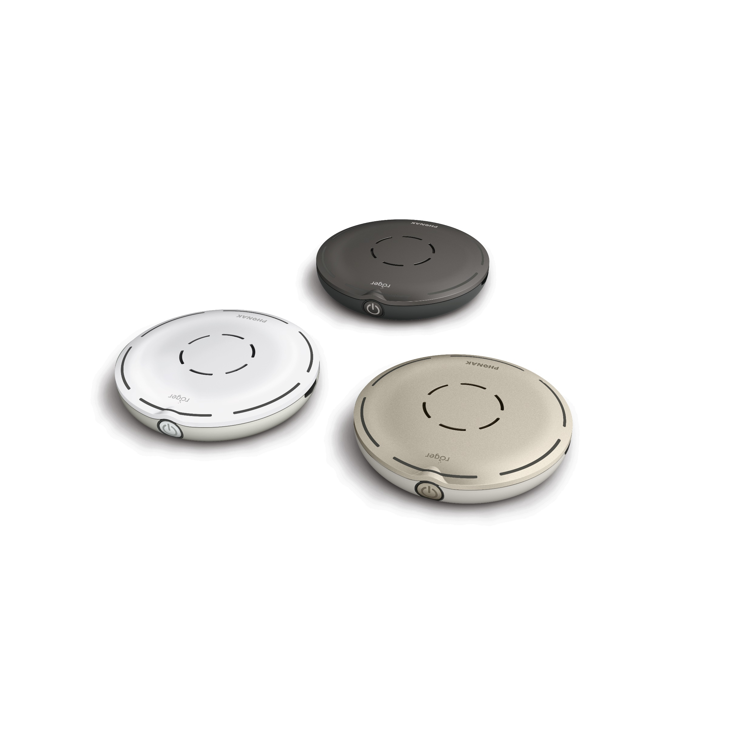
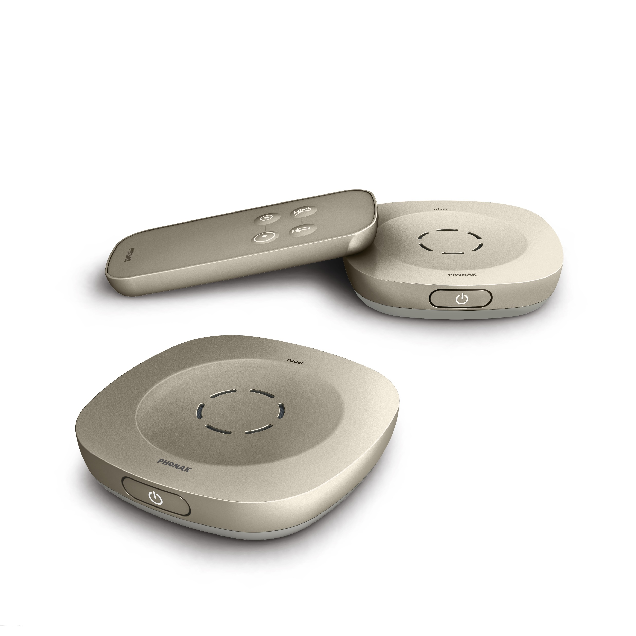
Phonak Wireless solutions
Listening Devices
Wireless technology to bridge that barrier and improve
clarity of speech
Designed to support speech in noise
Virtually compatible with any hearing aid
Receivers and Streamer
Roger Focus receivers
Integration
Notes:
having explained in the deaf awareness and business solution slides, all hearing aids picks up speech and noise equally, while people with hearing difficulties that don't wear hearing aids such as those with mild hearing loss or high frequency loss can benefit from solutions such as this technology to help them with their listening comprehension. because you're on a call you can hear their background noise, office environment noise and you're pressing on the ear piece of the phone or headset to listen really hard to help yourself trying to decimate the speech from noise. that involves repeating or asking direct questions with a yes or no answer to confirm what you've heard. it can be exhausting because of having to increase you focus and people tend to increase volume too which isn't good as it can distortion the speech or possibly damage your hearing further in the longer term.
other scenario is attending meetings, you could struggle to hear the speech from the other end of the table or from the presenter giving a presentation. Speech has to travel toward you with ambient in noise and the speech waves get weaker byt the time it reaches you, the reason why you might struggle to hear
how does this technology make a differences, the transmitter microphones are designed to improve the clarity of speech in noise by filtering some of the background noise away and amplify that speech before sending a signal to the receivers attached to your hearing aids. this solution block out the office environment noise and no need to have the volume setting at the maximum, meaning it easier on the ears and you don't have to strain yourself to listen very hard. these mics can easily be setup with companies telephony systems or use in meetings and it does make a difference cos thousand of people are using these solution to overcome their struggles when listening. The unique thing about these wireless transmitters, they virtually work with any hearing aid because all you need is micro receivers attached hearing device with what we call is audio shoes or a wireless streamer to pick the signal. Some might ask, why not just use the wireless streamer, unfortunately the software isn’t dynamic to make automatic changes to filter speech from noise or improve that clarity of speech.
for those that have mild hearing loss or high frequency loss that do not wear hearing aids, they can use receivers called Roger Focus that’s sit on your ears, with tube insert in the ear canal, looks similar to the hearing aid but won’t work without using one of these microphone. these roger focus receivers can help those that have auditory processing disorder, autism spectrum disorder or unilateral hearing loss because you’re sending the speech signal directly to the ears bypassing the ambient in noise, hence bridging the listening gap that improve the focus to hear and not having to strain yourself to hard, therefore going home less exhausted or stressed.
You’ve got the kit but how do you get all this to work with the companies hardware system? This is where we step in as we’ve got years of experience of integrating these solutions with computers, desk phones, meeting environments, etc... By providing the right cables, audio shoes, Bluetooth dongles and explain what need to be done before a visit by the trainer to setup up, such as visit audiologist and show how to use the equipment effectively.

Slide 23
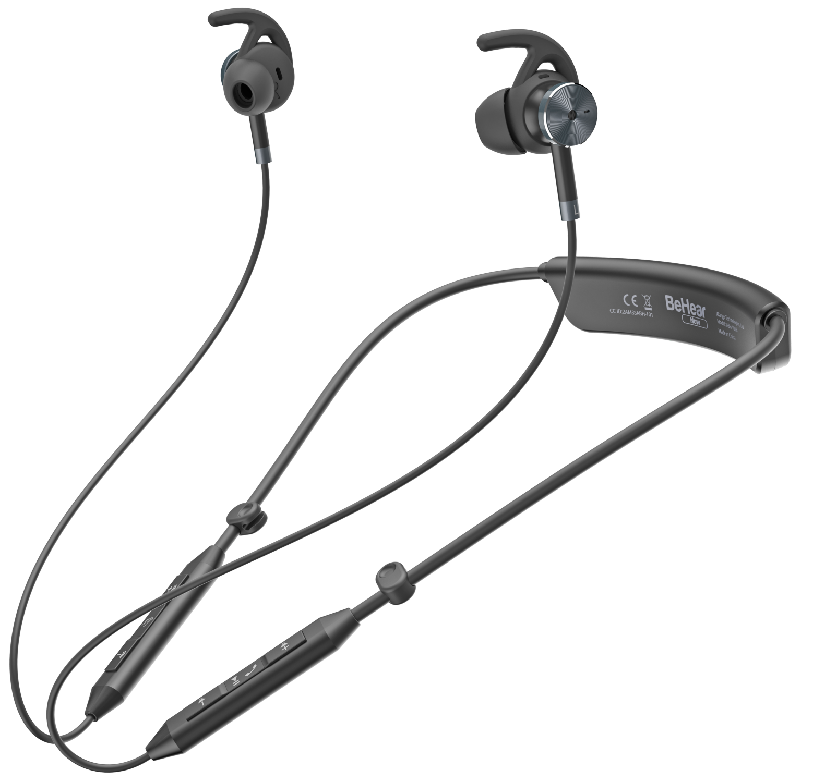
ASSISTIVE HEARING HEADSET
Listening Devices
Wireless earphones for live conversations,
mobile calls and stream audio.
Designed for people with mild to moderate hearing loss
Only amplifies frequencies where you need a boost
Improves clarity of speech understanding
Can be used independently or with app
4 different preset hearing modes for different environments
Optional integrated telecoil for induction loop systems
Notes:
Here’s an Alternative solution for people with mild to moderate hearing loss or specific loss of frequencies that don’t wear hearing aids, looks like a sport style headset but it’s actually what we call a assistive hearing headset that developed by sound engineers and certified audiologists to engage in conversations, take mobile calls with more confidence and hear TV, videos or music stream directly to their ears. You could be on a call and missing out some words or not hearing those word you’re not familiar with. with this solution you can have an app on the smartphone to control these lost of frequencies by increase the volume of those audio sounds, it only need to be done once which are stored/saved in the wireless headset to improve the clarity of speech understanding. Can be used independently once hearing assessment is completed via app. With a smartphone there are pre-set settings for indoor, outdoors, in crowd and live music and an option of having integrated telecoil for induction loop system.

Slide 24
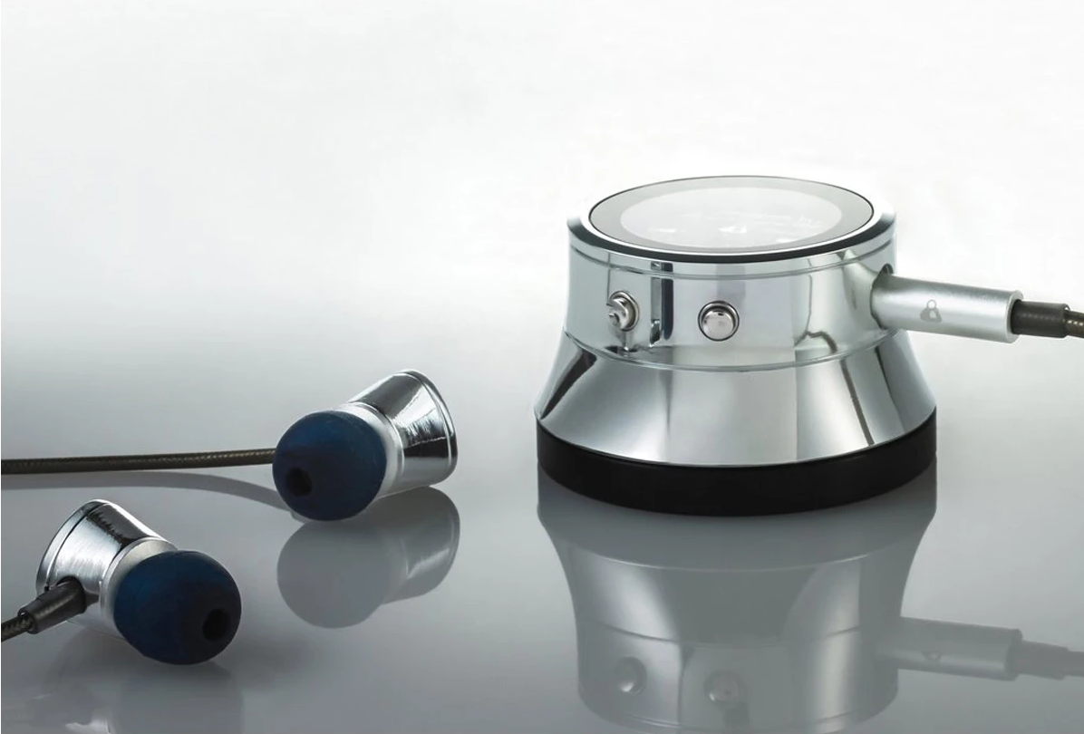
DIGITAL STETHOSCOPE
ThinkLabs One
The smallest, clearest sounding stethoscope in the
world that fits in the palm of your hand.
Designed for people with hearing loss
Amplify the sound of heart beats
Design to reduce ambient noise
Works with compatible hearing devices
Use with earphones or large headphones
Can be use for Veterinarian doctor as well as in medical environments
Notes:
Thinklabs one, a digital stethoscope that fit in the palm of your hand and has the best clearest sounding stethoscope in the world design for people with hearing loss by increasing the bass level to amplify the sound of heart beats. Works with a whole range of hearing devices such as streamers to hearing aids or cochlear implant. For those without hearing aids they can use earphones provided, alternatively use large over the ears headphones. A stethoscope like this can inspire deaf people to become Vets, paramedic, nurse, doctor or keep those in existing jobs with hearing loss.

Slide 25
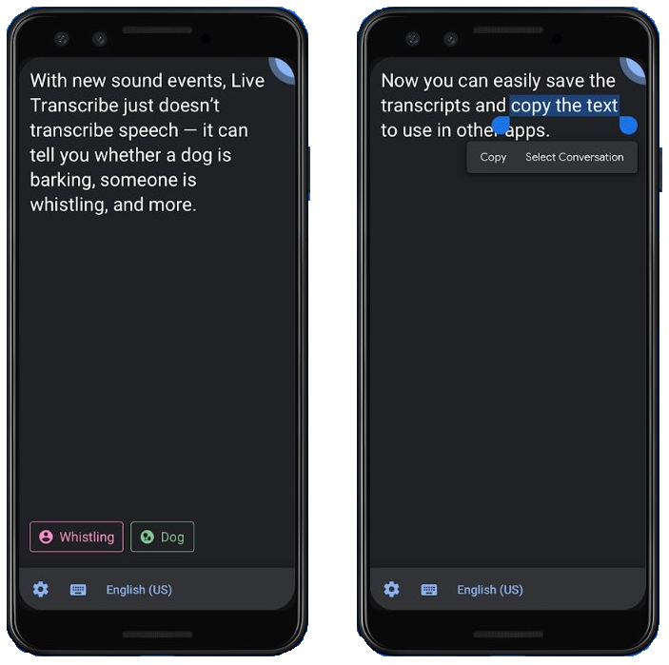
GOOGLE LIVE TRANSCRIBE
Smart Phone Apps
GOOGLE LIVE TRANSCRIBE
Live Transcribe provides real-time transcription and sends notifications based on the surrounding sounds at home.
Making everyday conversations and surrounding sounds
more accessible.
Transcribe in realtime
Saved transcripts for 3 days
Notification alerts to fire alarm and door bell
Can use wired or wireless headsets
Only works on Android devices
Notes:
Similar to Microsoft group transcribe, with Google own technology in providing live transcription and live sound notifications based on your surrounding at home making your conversations more accessible and know when the door bell has been rang.
Transcribe in realtime with text appearing on screen as words are spoken. I can’t vouch for the level of accuracy, like all the other automatic speech recognition software, it’s down to the quality of the speech and the environment.
You can save the transcripts allowing you to copy and paste them to document or emails, etc… for review, need to do that within 3 days
This sound Notification option alert you to potential risky situations and personal situations based on sounds happening at home (for example, smoke alarm, siren or baby sounds). Don’t have an android device to tell if microwave beeps or hear the baby sounds. Getting the notifications is a flashing light or vibration from mobile device or smartwatch.
Can use bluetooth headset so in 1-2-1 situation, you could have a mic near your mouth and someone else holding device to read the live text. This app only works on android device and can’t use separate phones to link for group discussion like Microsoft group transcribe.

Slide 26
FOR FURTHER INFORMATION
PLEASE CONTACT US
Microlink pc (UK) Ltd
Microlink house
Brickfield Lane
Chandler’s Ford
Hampshire
SO53 4DP
T +44 (0)2380 240342
M +44 (0)7540 117300
E michael.buckfield@microlinkpc.com
www.microlinkpc.com
Company registered in England No. 03325643
PRESENTATION:
Michael Buckfield, Research & Development and AT Consultant
Notes:
Hope you enjoyed this session and do get in touch if you want further information about these product, have a great day!

