Slide 1
e-Learning to learn about Assistive Technology and Accessibility
Thursday 24th June

Slide 2
Overview
INTRODUCTION
Overview
Digital accessibility and assistive technology
What are the potential barriers?
How do you overcome these barriers?
Accessibility e-learning
Conclusion and Q&A
1/20
Notes:
Overview
This presentation will cover
Digital accessibility and assistive technology.
What the potential barriers are for disable people.
How you can overcome these barriers.
Find out more about our accessibility e-learning platform and to see some of its features.
The presentation will conclude followed by a workshop Q&A session.

Slide 3
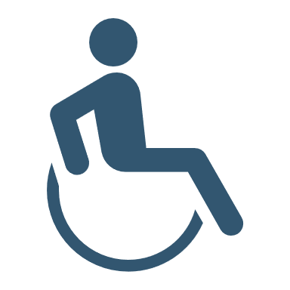
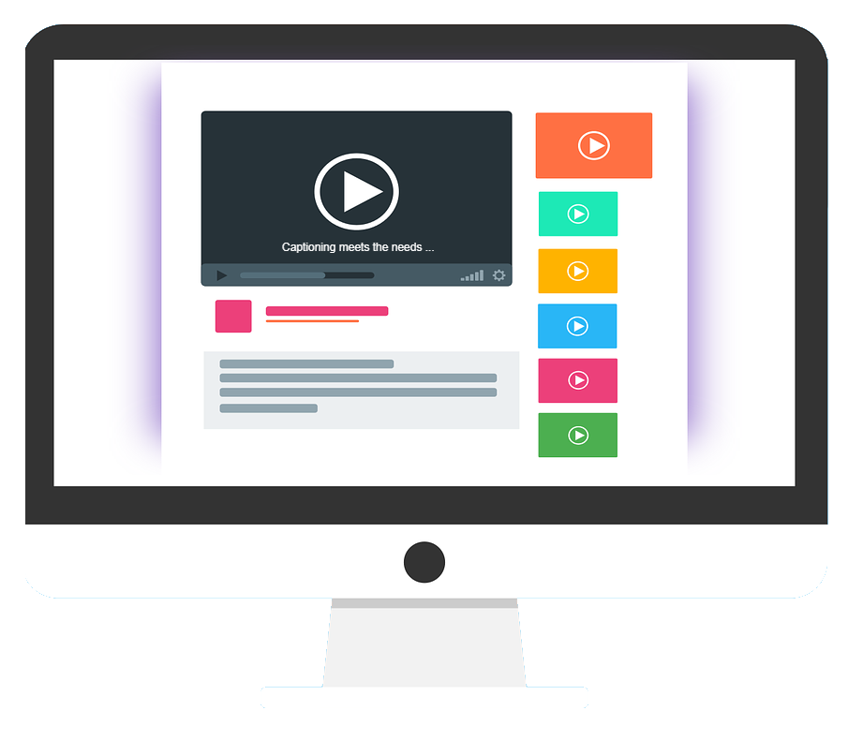
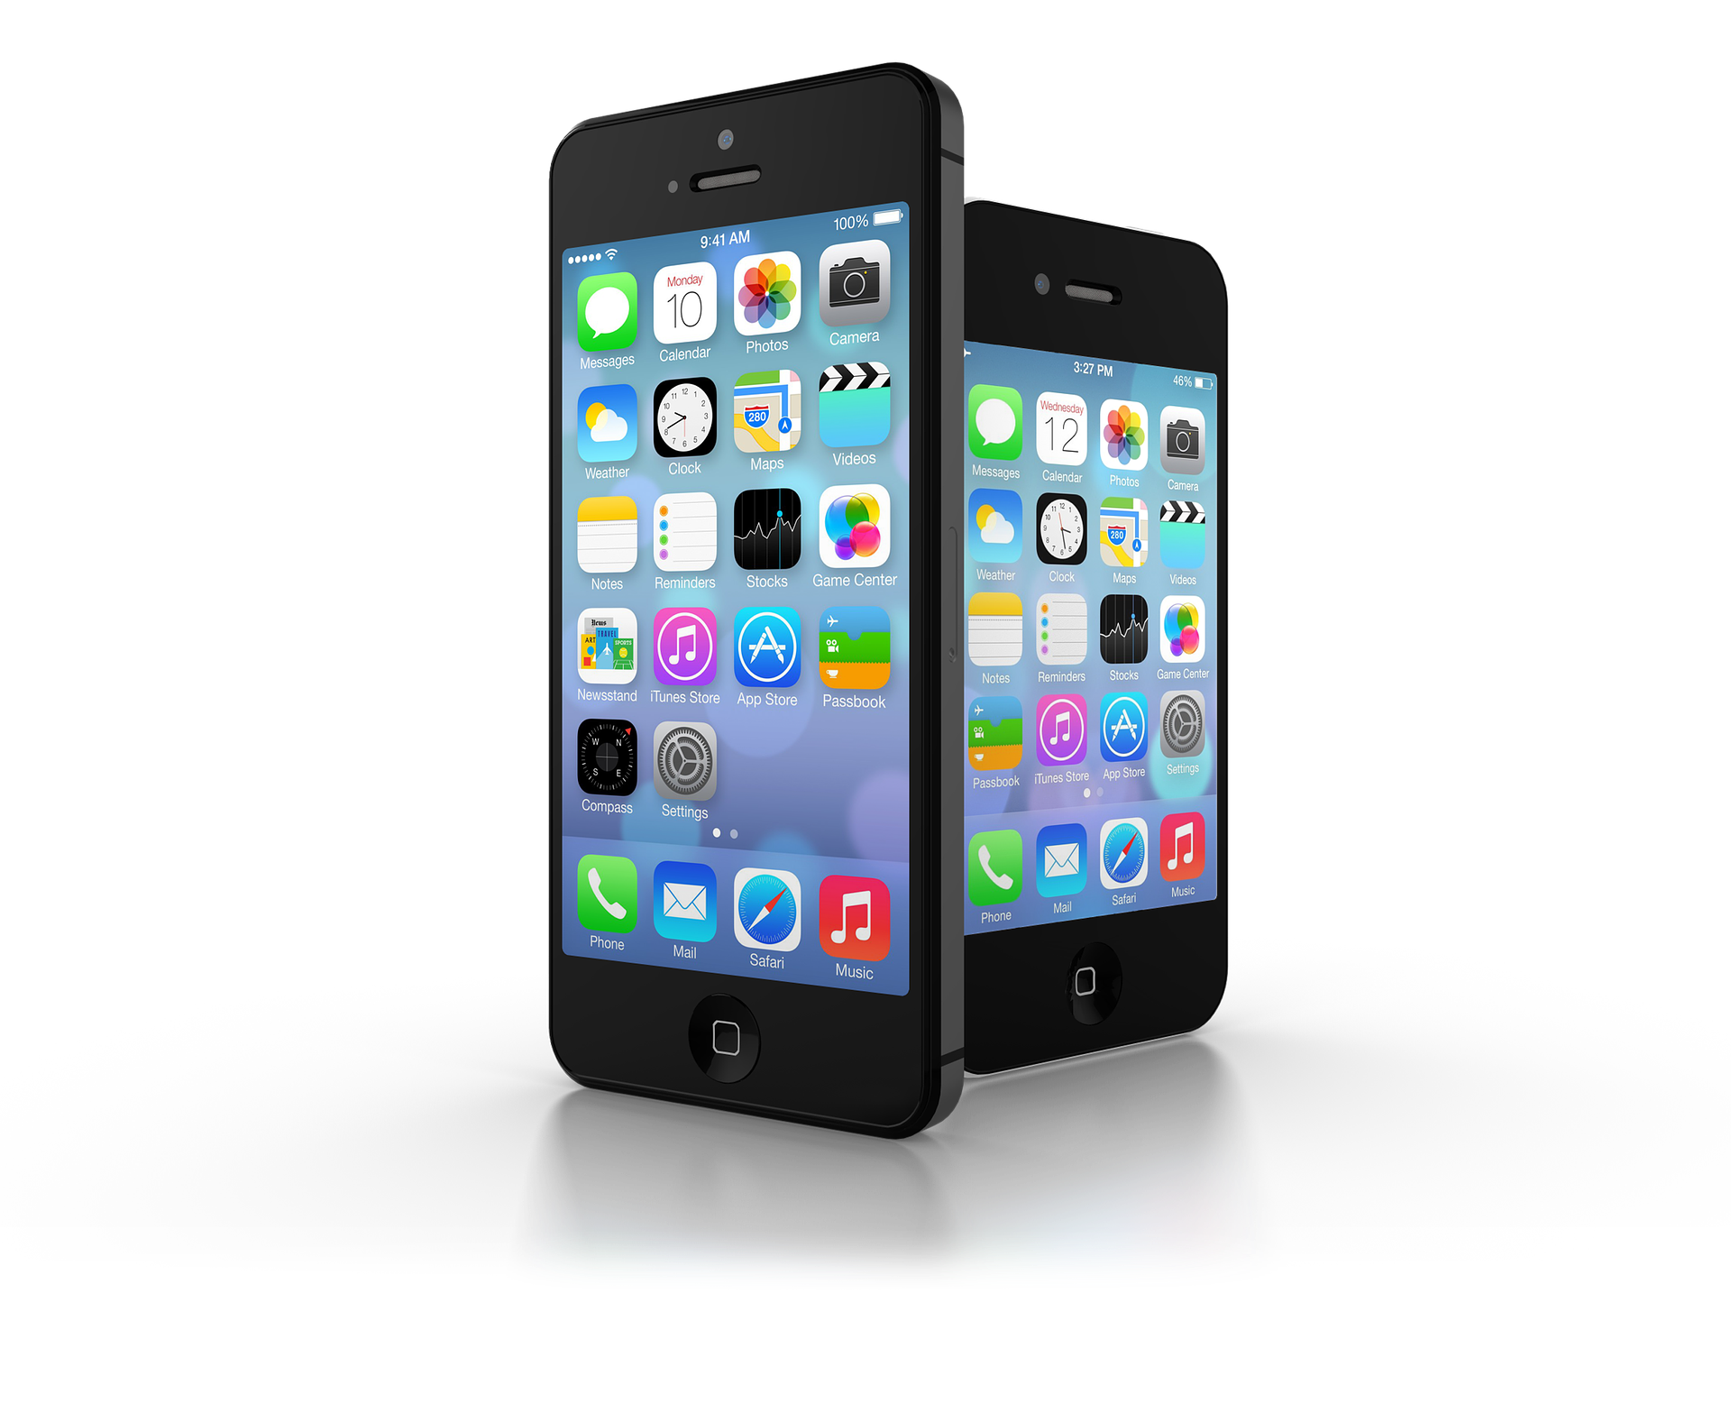
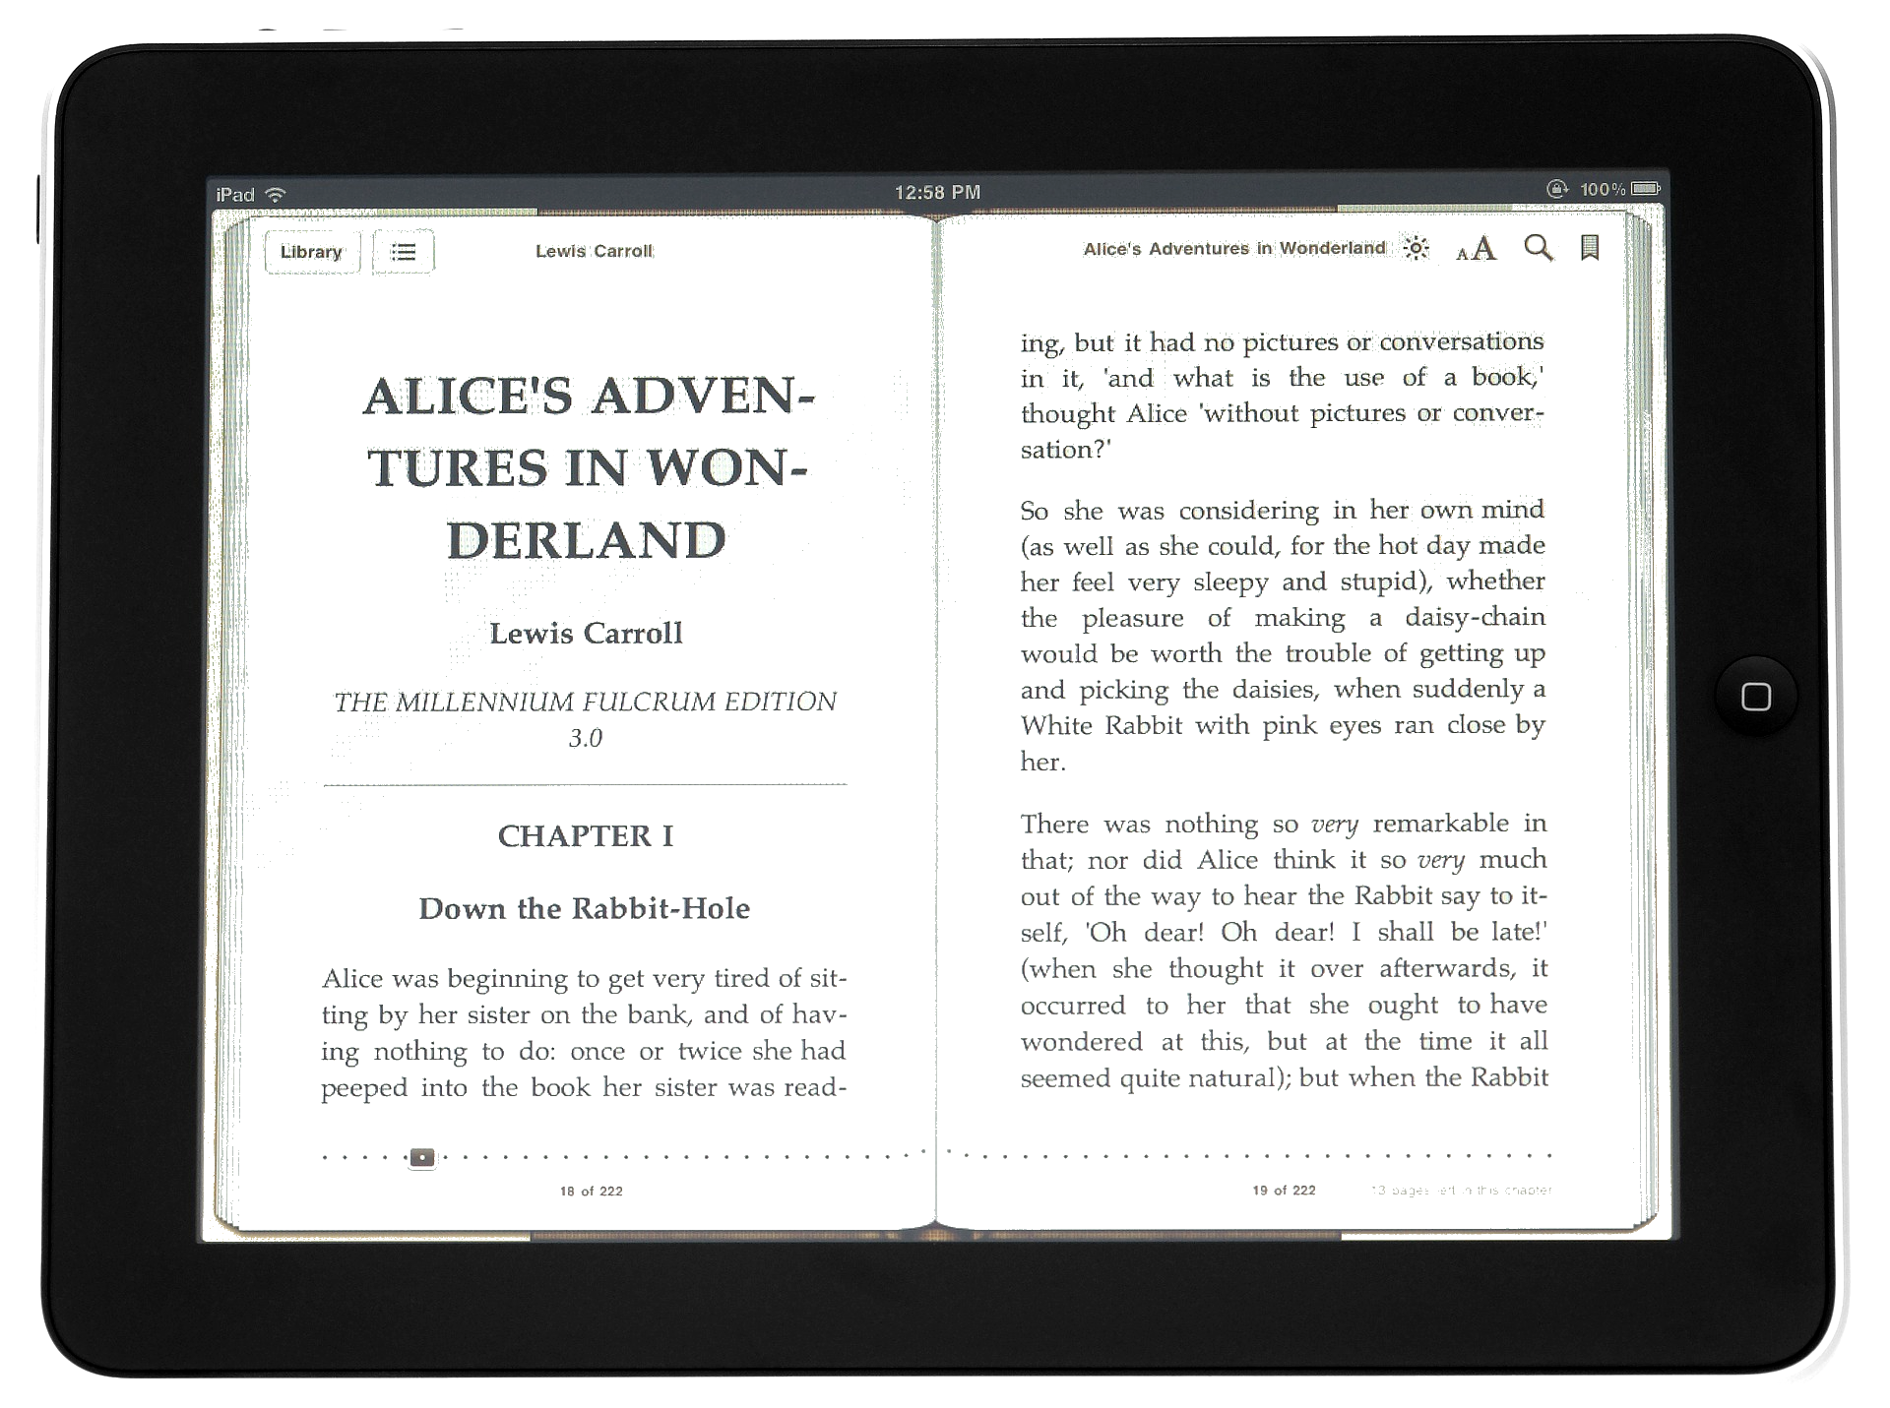

What is digital accessibility?
DIGITAL ACCESSIBILITY
What is digital accessibility?
Process: ensuring digital technologies, services, and resources, such as websites, mobile apps, ebooks and documents are:
  Designed: accessibility requirements
  of disabled people.
  Flexible and customisable: meeting
  individual needs.
  Lexdis, 2021
2/20
Notes:
What is digital accessibility?
Digital accessibility is the process of ensuring digital technologies, services and resources, such as websites, mobile apps, e-books and documents are:
Designed with the needs of disabled people and additional needs in mind
Flexible and can be [customised] to meet individual needs.
Continued on next slide.

Slide 4


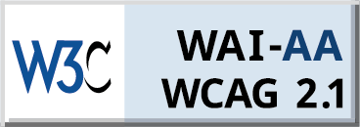
What is digital accessibility continued
DIGITAL ACCESSIBILITY
What is digital accessibility?
  Created: compatible with assistive technology (AT), such as screen readers.
  Compliant: recognised accessibility guidance and regulations.
  Lexdis, 2021
3/20
Notes:
What is digital accessibility?
Created so that they are compatible with assistive technology.
Compliant with recognised accessibility guidance and regulations.

Slide 5

Public Sector Bodies Accessibility Regulations (PSBAR)
DIGITAL ACCESSIBILITY
Public Sector Bodies Accessibility Regulations (PSBAR)
Public sector organisations: legal duty to ensure their websites and mobile applications meet accessibility regulations.
All public sector websites: accessible and compliant to
WCAG 2.1 Level AA.
Include and update an Accessibility Statement on their website.
(CDDO, 2021)
4/20
Notes:
Why do you need to be compliant?
Public Sector Bodies Accessibility Regulations (PSBAR)
Public sector bodies have a legal duty to ensure that their websites and mobile applications meet accessibility regulations.
All public sector websites should now be accessible and compliant to WCAG 2.1 Level AA.
They should now include and update an Accessibility Statement on their website.

Slide 6


PSBAR continued
DIGITAL ACCESSIBILITY
PSBAR
Pre-recorded audio and video published after
23 September 2020.
PDFs or other documents published after 23 September 2018.
Accessibility requirements for new, existing, or outsourced mobile apps apply. The deadline: 23 June 2021.
(CDDO, 2021)
5/20
Notes:
PSBAR continued
The following are items that must be addressed to comply with the regulations.
Pre-recorded audio and video published after the 23 September 2020.
PDFs or other documents published after 23 September 2018.
The accessibility requirements for new, existing, or outsourced mobile applications also apply. The deadline for this was yesterday.

Slide 7




Who does digital accessibility affect?
DIGITAL ACCESSIBILITY
Who does digital accessibility affect?
The goal: digital products - usable by disabled people
  Without vision or with limited vision.
  Without perception of colour.
  Without hearing or with limited hearing.
(Lexdis, 2021)
6/20
Notes:
Who does digital accessibility affect?
The goal of digital products is that they need to be usable by disabled people
Without vision or with limited vision.
Without perception of colour.
Without hearing or with limited hearing.
Continued on next slide.

Slide 8



Who does digital accessibility affect continued.
DIGITAL ACCESSIBILITY
Who does digital accessibility affect?
  With limited dexterity.
  With limited cognition.
  Without speech.
(Lexdis, 2021)
7/20
Notes:
Who does digital accessibility affect?
With limited dexterity.
With limited cognition.
Without speech.

Slide 9


What is Assistive Technology?
ASSITIVE TECHNOLOGY
What is Assistive Technology?
‘Assistive technology (AT) is any item, piece of equipment, software program, or product system that is used to increase, maintain, or improve the functional capabilities of [a disabled person].’
(ATIA, 2021)
8/20
Notes:
What is Assistive Technology?
‘Assistive technology (AT) is any item, piece of equipment, software program, or product system that is used to increase, maintain, or improve the functional capabilities of [a disabled person].’

Slide 10
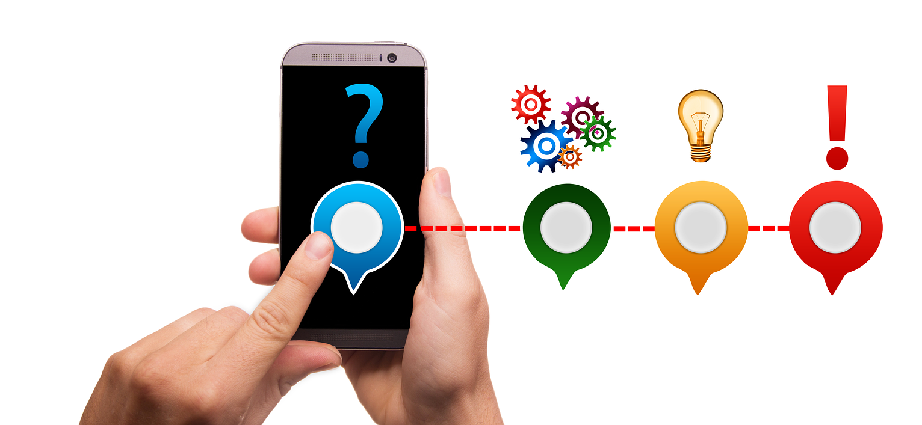
ASSITIVE TECHNOLOGY FEATURES
WHAT?
AA
ASSITIVE TECHNOLOGY FEATURES
Awareness by users of
assistive technology.
Non-technical:
Users may be non-technical
requiring support, information
or training on demand.
9/20
Notes:
ASSITIVE TECHNOLOGY FEATURES
Users, for example, may know they need to alter font size but may not be aware that this relates to digital accessibility or assistive technology.
Users may be non-technical and require support, information or training on demand.

Slide 11








What are the potential barriers?
WHAT?
Impairment | Barrier | Impact (example) | Stakeholder Awareness
cognitive | No customisation | Distraction/ diff. reading | Limited
Without vision and with limited vision | No keyboard access | Prevents navigation | Some
Without colour perception | No shape/pattern | Non-distinguishable | Some
With limited dexterity. | No physical access | Prevents navigation | Limited
Without hearing and with limited hearing. | No captions audio desc. | Prevents use of video/call | Some
Without speech. | No text input or speech syn. | Prevents use of video/call | Limited
Combinatorial impairment:
E.g., age related due to onset
Situational impairment:
E.g., screen glare in
direct sunlight
10/20
Notes:
Describe the slide.

Slide 12

How do you overcome the barriers?
HOW?
Impairment | Solution | Impact (example) | Stakeholder Awareness
Cognitive | Customisation | Distraction/ diff. reading | Limited
Without vision and with limited vision. | Keyboard access | Navigation/ High Contrast | Some
Without colour perception | Shape/pattern | Information distinguishable | Some
With limited dexterity | Switch control | Navigation | Limited
Without hearing or with limited hearing. | Captions & audio desc. | Use of video/call | Some
Without speech | Text input or speech syn. | Use of video/call | Limited
Combinatorial impairment:
Include all solutions
in the table.
Situational impairment:
E.g., turn brightness up on your device.
11/20
Notes:
Describe the slide.

Slide 13


BEST PRACTICE
HOW?
BEST PRACTICE
Authoring accessible digital content prevents future remediation.
Recommend: habit forming approaches when authoring documents to minimise accessibility barriers.
Ensure: stakeholders are aware
of this information.
12/20
Notes:
BEST PRACTICE
It is important to realise that authoring accessible digital content prevents future remediation.
We recommend adopting habit forming approaches when authoring documents to minimise accessibility barriers.
Ensure that all stakeholders are aware of this information.

Slide 14
What digital accessibility solutions does Microlink provide?
HOW?
What digital accessibility solutions does Microlink provide?
Accessibility e-Learning
Web
Mobile
Format
Authoring accessible digital content
Increasing awareness and use of AT
Auditing websites
to WCAG 2.1 AA using manual testing & automatic tools
Accessibility statements
Live captioning
Testing responsive mobile websites
& applications to
WCAG 2.1 AA
High volume PDF
remediation to
PDF 1.7 & PDF/UA also enabling disabled people to earn through a
Kick Start Scheme
Conversion to EPUB3
13/20
Notes:
Broad brush strokes of the digital accessibility services we offer at Microlink.
Describe slide (simply).

Slide 15
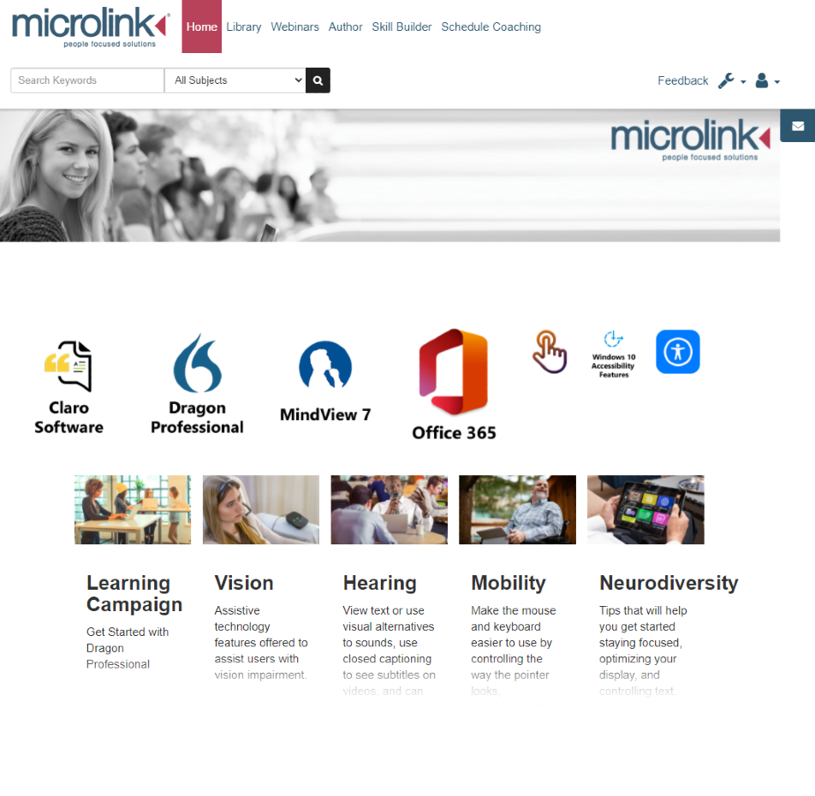
ACCESSIBILITY E-LEARNING
14/20
Notes:
For this workshop
I am going to be focusing on our accessibility e-learning tool.

Slide 16
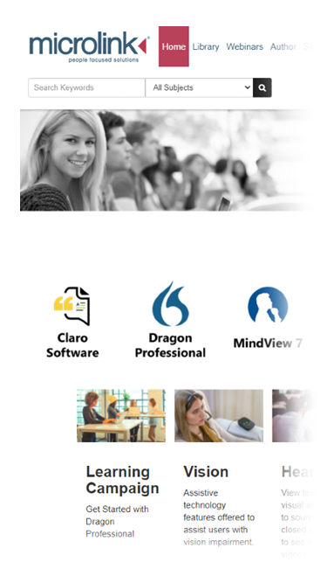
Digital accessibility learning platform
ACCESSIBILITY E-LEARNING
Digital accessibility learning platform
Uses learning campaigns: teaching stakeholders how to author accessible digital content using mainstream software.
Teaches stakeholders about Assistive Technology and how to use software, such as Claro Read or Dragon Naturally Speaking.
15/20
Notes:
Digital accessibility learning platform
The platform uses learning campaigns to teach stakeholders how to author accessible digital content using mainstream software, such as Office 365.
It also teaches stakeholders about the availability of Assistive Technology and how to use mainstream AT software, such as Claro Read or Dragon Naturally Speaking.

Slide 17
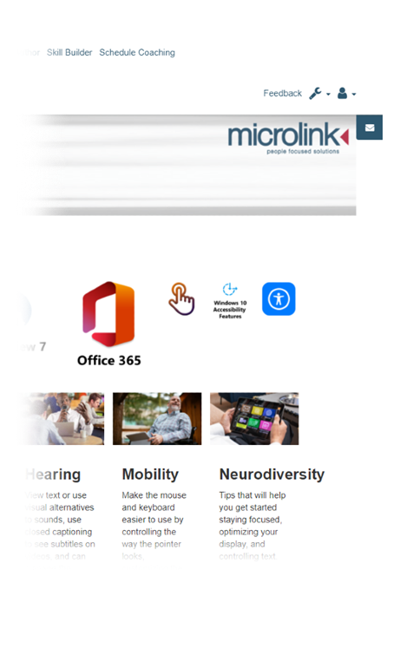
Digital accessibility learning platform continued
ACCESSIBILITY E-LEARNING
Digital accessibility learning platform
Neurodiversity for example, is a dedicated learning campaign.
50,000+ video tutorials for using
mainstream software.
Integrates: with existing Learning Management System (LMS).
16/20
Notes:
Digital accessibility learning platform
One of the dedicated learning campaigns is for Neurodiversity.
The platform also has over 50,000 video tutorials for using mainstream software.
And also integrates with existing Learning Management System (LMS).

Slide 18
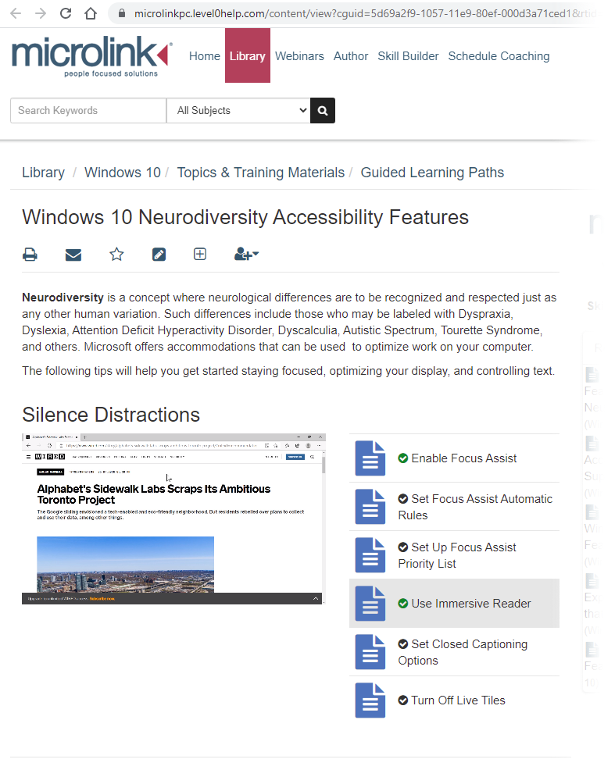
Examples of platform features:
ACCESSIBILITY E-LEARNING
Examples of platform features:
Learning campaigns: cover vision, hearing, mobility and neurodiversity (cognitive impairments, such as dyslexia).
For example, using the immersive reader for neurodiversity.
17/20
Notes:
Examples of platform features:
The digital accessibility learning campaigns cover vision, hearing, mobility and neurodiversity (this refers to cognitive impairments, such as autism, dyslexia or ADHD).
Under neurodiversity one of the tutorials demonstrates using the immersive reader for neurodiversity.
I am now going to demo this for you.

Slide 19
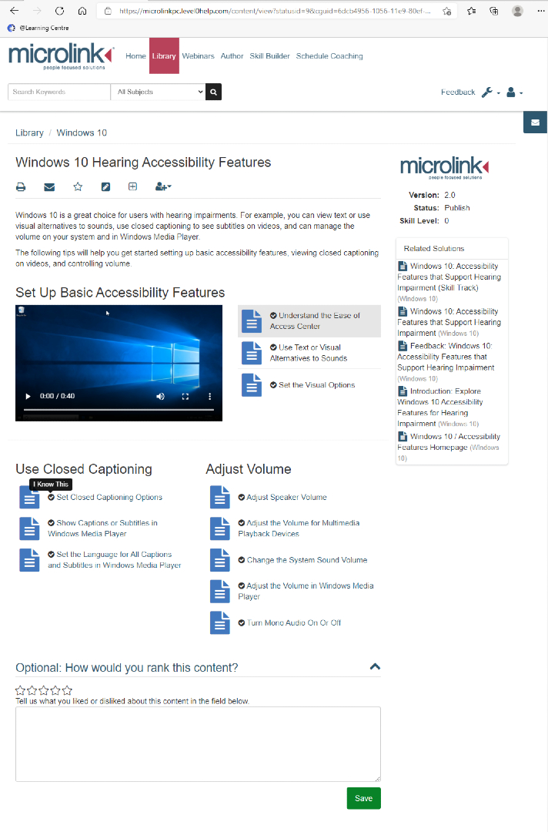
Examples of platform features continued
ACCESSIBILITY E-LEARNING
Examples of platform features:
Select: what you already know about Digital Accessibility for lessons.
For example, if you already know how to set captioning options.
18/20
Notes:
Examples of platform features:
The platform also enables you to select what you already know about Digital Accessibility for lessons.
For example, you may already know how to set captioning options. By selecting that you know it, it is not included in the lesson.

Slide 20
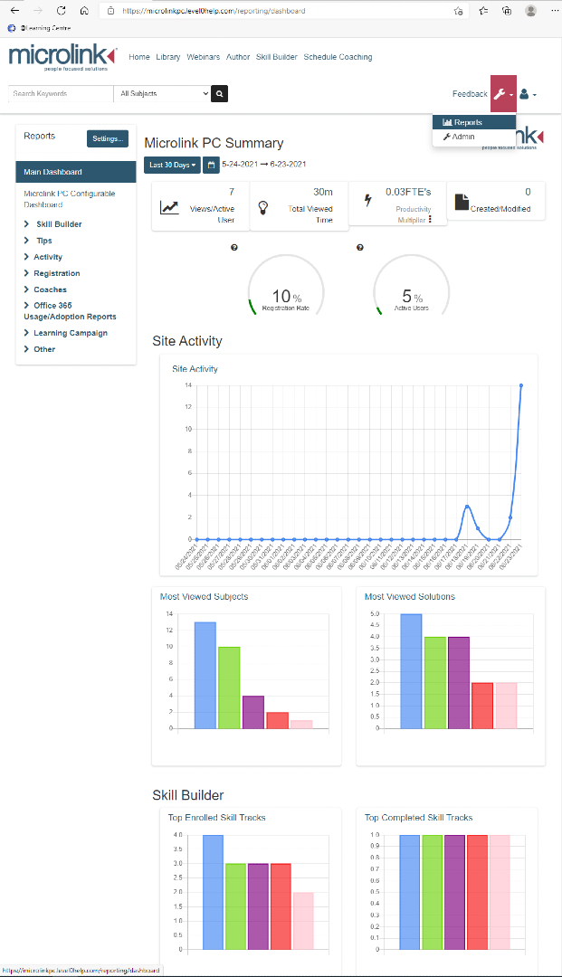
Examples of platform features continued
ACCESSIBILITY E-LEARNING
Examples of platform features:
Measure adoption: of your accessibility training & assessment across your organisation.
Viewing a report on the dashboard.
19/20
Notes:
Examples of platform features:
The platform enables you to measure the adoption of your accessibility training & assessment across your entire organisation and to determine when adoption occurred.
I am now going to demonstrate how to view a report on the dashboard.

Slide 21

Take ‘home’ message.
CONCLUSION
Take ‘home’ message.
Making a difference: author accessible digital content and increasing awareness of AT.
Accessibility e-learning: helping you and your organisation.
Everyone benefits: particularly during and after COVID-19.
20/20
Notes:
Take ‘home’ message.
You can make a difference by authoring accessible digital content and make others aware of assistive technology.
The Microlink digital accessibility e-learning platform is designed to help you and your organisation, partners, clients and customers learn about accessibility and the availability of AT in short easy step by step learning campaigns.
Remember this, everyone benefits from digital accessibility, particularly during and after the pandemic.

Slide 22

Questions
QUESTIONS?
Do you have any questions?
Notes:
Do you have any questions?

Slide 23
THANK YOU
Presented by
Dr Neil Rogers, Head of Digital Accessibility
Microlink PC (UK) Ltd
Microlink house, Brickfield Lane, Chandler’s Ford, Hampshire
SO53 4DP
T: +44 (0)23 80240300
E: wpa@microlinkpc.com
www.microlinkpc.com
Company registered in England No. 03325643
Notes:
Thank you

