Slide 1
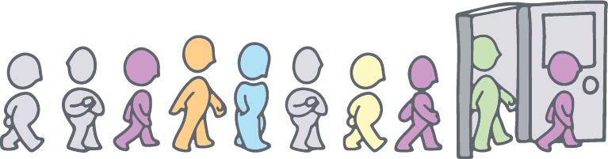




Neurodiversity Awareness
Martina Foreman BA hons
Associate coach and trainer
Neurodiversity is our Passion
GeniuswithinCIC
@geniuswithinCIC
Genius Within CIC
@GeniusWithinUK
Notes:
Pop your own name in, obvs!

Slide 2
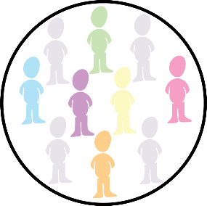
Session Outcomes
Neurodiversity in the Workplace
1
Intro to Neurodiversity
Hidden disability
Exclusion & inclusion
Diagnosis deficit
2
Workplace Impact
What might you notice?
Strengths and Challenges
Inclusion is a moral, social and economic imperative. We all lose when diverse human potential is squandered
3
Supporting Colleagues
Systemic inclusion
Managing Diversity in Performance
© Genius Within CIC. All rights reserved

Slide 3
What is hidden disability?
What is
Hidden Disability?
Applied
Clinical
Acquired (transient)
Acquired (Chronic)
Dyslexia, DCD, Dyscalculia, Dysgraphia
Born with condition
Relates to applied, educational skills, such as reading or motor control
Tourette Syndrome, Autism, & ADHD
Born with condition
Relates to behavioural skills such as communication and self control
Develops in response to a health condition
Neurological illness or brain injury
Not considered a health condition
Considered a health condition
This group could be expanded to include intellectual difficulties
Could return to ‘neurotypical’ if health condition improves
Develops in response to a health condition
Potentially resolves as injury heals or worsens as health deteriorates
Mental health condition leading to [potentially]
Source: Weinberg and Doyle 2017: British Psychological Society
Notes:
We usually consider these conditions under the banner of neurodiversity
But Judy Singer, the originator of the term, meant it to be related to all humans, the natural neurocognitive variation in the human species
Discuss different labels – neurodiverse, neurodivergent, neurominority, SpLD, neurodevelopmental disorders, hidden disability

Slide 4

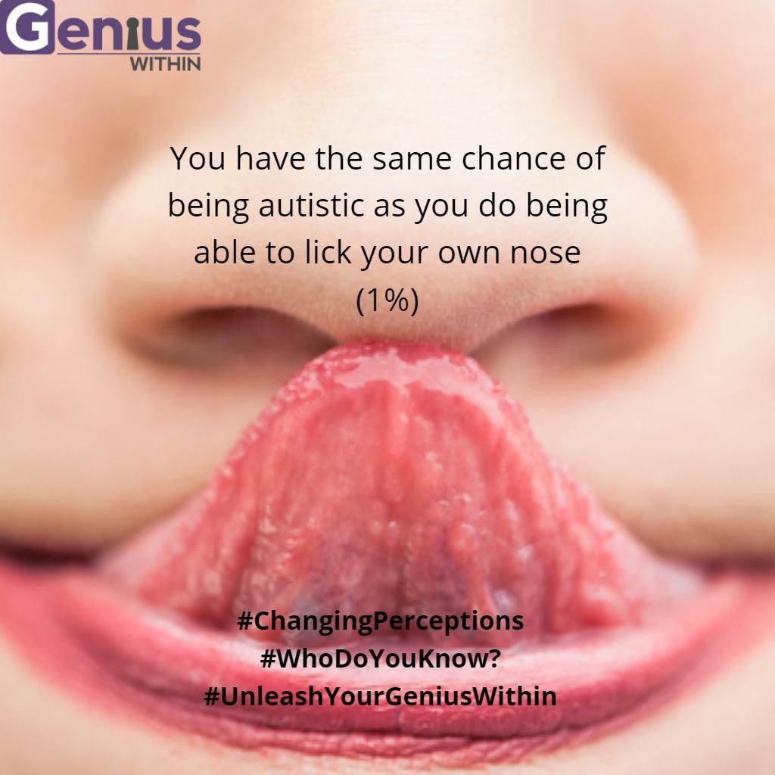
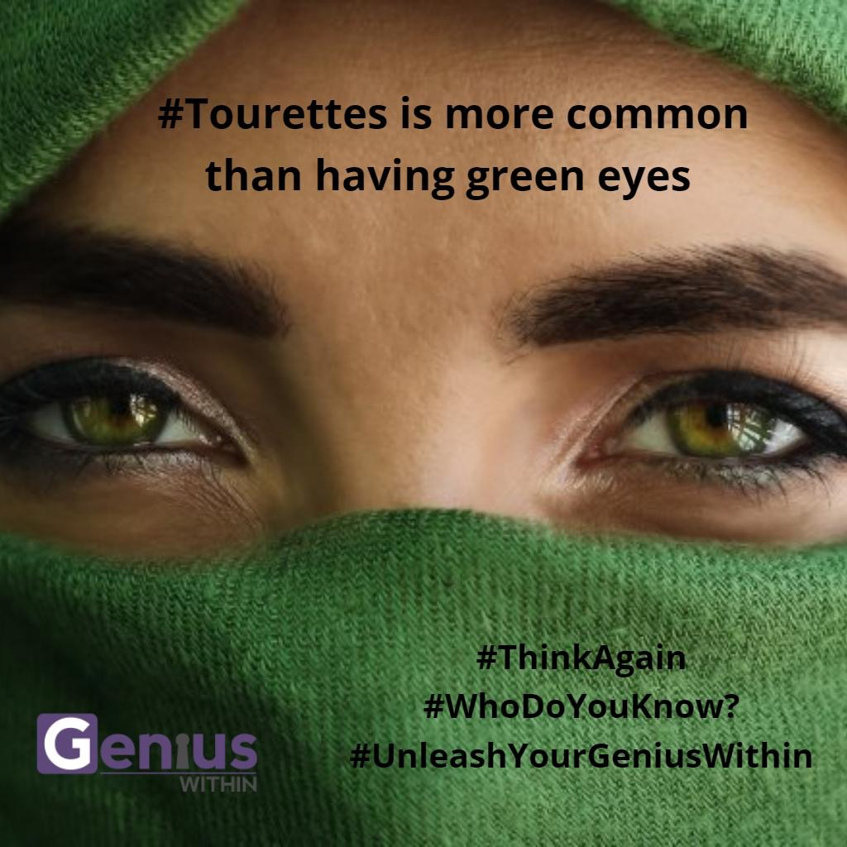
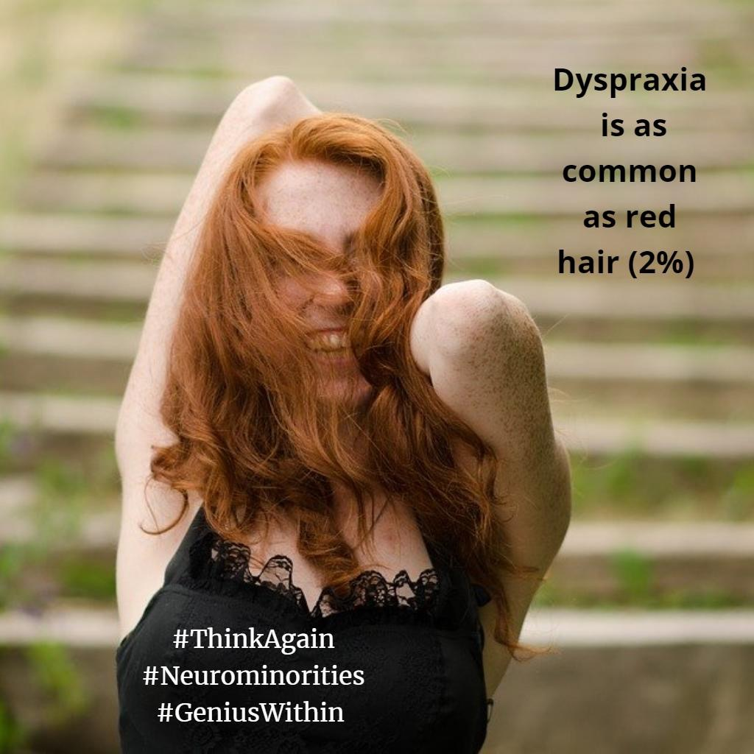
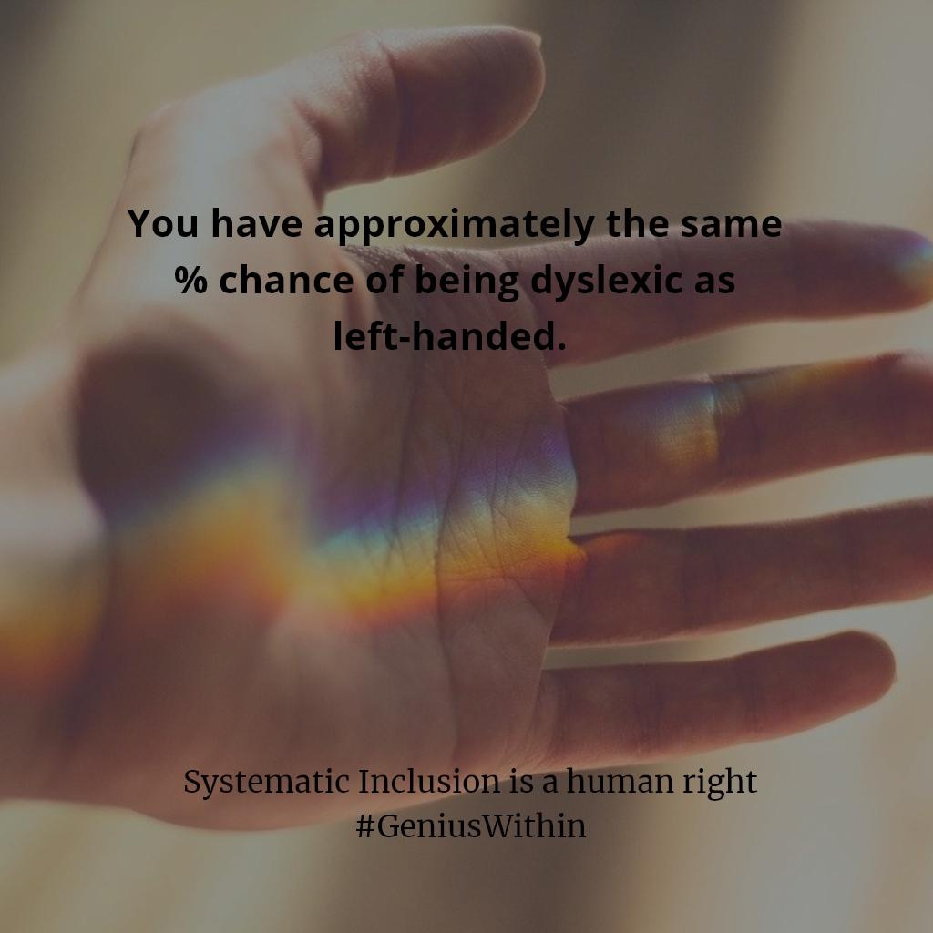
Awareness Training
Changing Perceptions
#ThinkAgain
#UnleashYourGeniusWithin
#WhoDoYouKnow
Notes:
Some of you may have seen our Awareness campaign running across our social media channels.
This looks at other physical traits, and draws parallels with hidden disabilities to encourage a positive reframing of conditions.

Slide 5
1%
of disabilities are not visible.
……1 in 7 have mental health needs
Cost to economy £26 billion each year.
Source – Business Disability Forum
Notes:
90% of disabilities are not visible

Slide 6
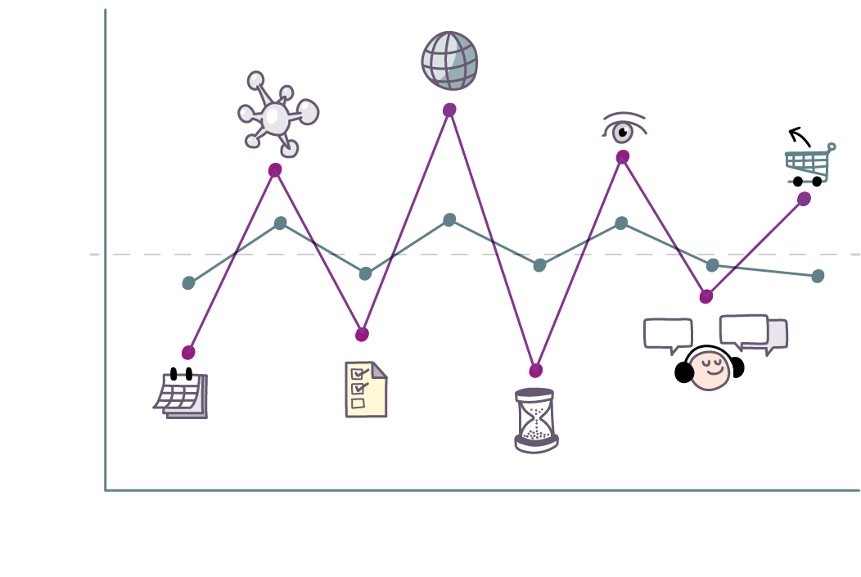
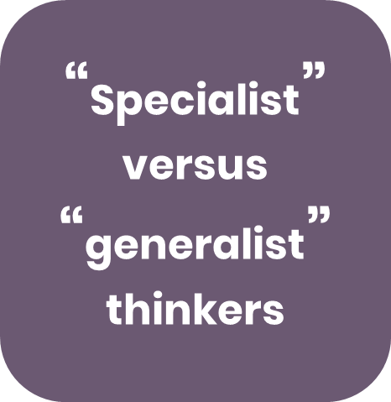
The Impact
Notes:
Spiky profile : average intelligence ( middle dotted line ) strengths and weaknesses are likely to be more extreme than someone who is neuro typical.
Strengths are likely to be:-
Perceptual Reasoning: visual thinking, seeing the bigger picture, noticing patterns or that something doesn't add up, connecting ideas, thinking outside the box.
Verbal Reasoning: ability to ask the right questions. Articulate the point, explain and describe concepts.
Challenges:
Memory: struggle to remember what they have heard, working memory e.g. processing a number of thoughts or actions at one time.
Processing Speed: focusing attention: visually scanning and sequencing information, making quick decisions on detailed information in the moment > leads to problems with time management, organisation, planning and prioritising, dealing with distractions (as seen on previous slide)

Slide 7

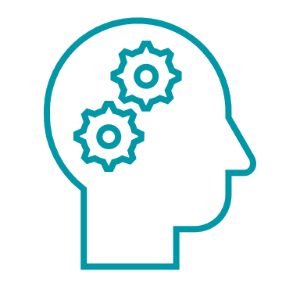
What are the
spikes?
Perceptual Reasoning
Verbal Reasoning
Processing Speed
Working Memory
Define project goals
Visual and mechanical thinking
Identifying the bigger picture
Noticing patterns or that something is different
Ability to ask the right questions
Articulate the point
Explain and describe concepts
Making links between ideas and advanced constructs
Focusing attention: visually scanning and sequencing new information
Making quick decisions on detailed text or code like information in the moment
Hold onto details of you what you have seen or heard, long enough to act on it
Processing several thoughts or actions at one time

Slide 8
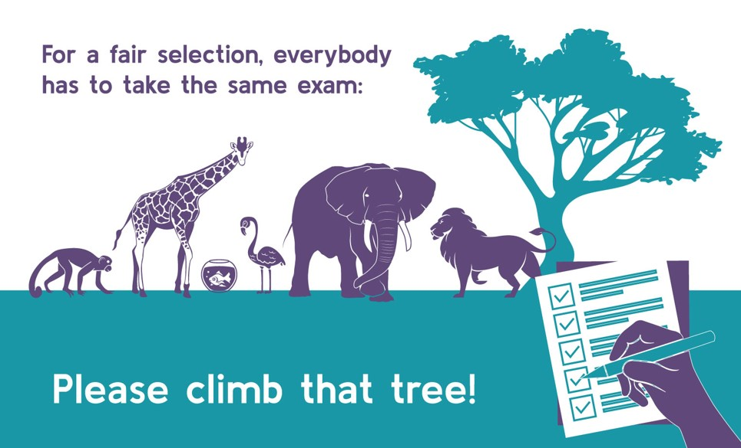
Please climb that tree
Notes:
What you might notice
Uneven performance
Poor “fit”
If you are in charge of a tree climbing team, you might not think the fish was valuable. If you were the apple picking team manager, you might love the elephant as much as the monkey

Slide 9
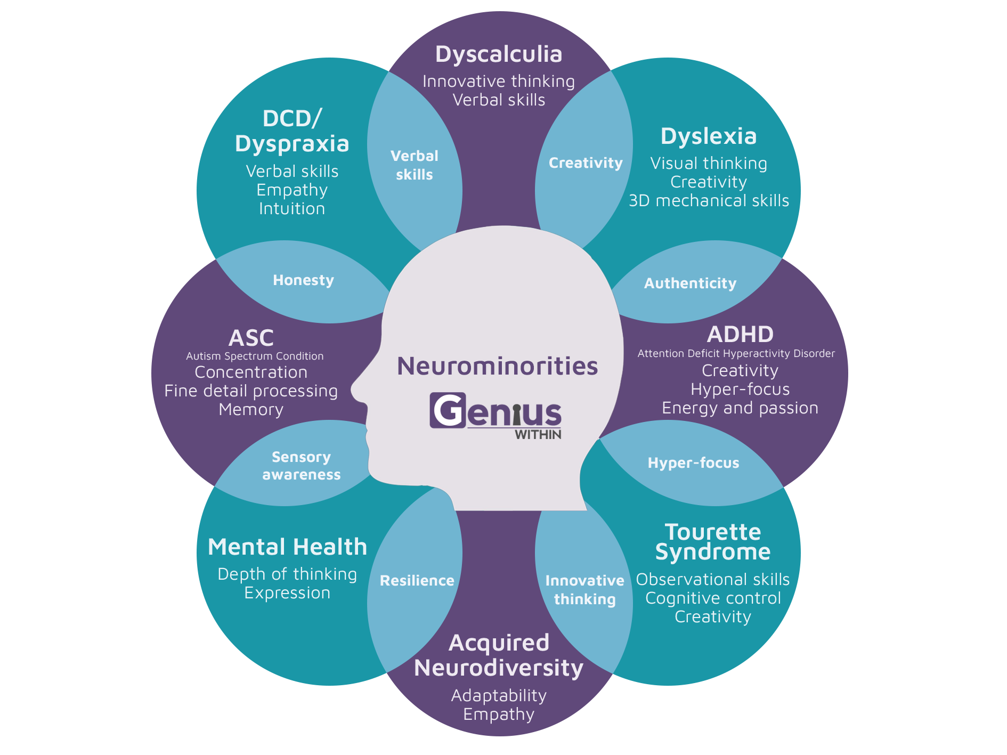
Neurominorities
Neurominorities
Whole population prevalence
Estimated to be around
15-20%
Source: Dr Nancy Doyle, based on the work of Mary Colley
Notes:
You will notice these strengths

Slide 10




Normal Activities
Normal
Activities
92%
83%
78%
Memory /Concentration
67%
Organisational Skills
Time Management
Communication
Doyle and
McDowall, 2015
Notes:
What does this look like in a workplace? – actually a lot of commonality between conditions and how they affect “normal activities”
These are the troughs at the bottom of the spiky profile
Memory
Especially working memory (the ability to hold and work with short-term information in their head), which can result in difficulties with taking phone messages and keeping track in meetings.
Also problems in taking in and learning new information, and with lapses in memory.
Organisation – planning and prioritising tasks,.
Maintaining organisational skills, including increased difficulties with juggling a number of tasks. Some people also describe putting off challenging work.
Time Management
It can take longer to do tasks, leading to decreased productivity at work. Some people may work far longer hours to get work done.
Concentration
Some people also find it harder to keep focus at work and easier to get distracted, leading to their thinking ability slowing down
Harder to make decisions. Anxiety has also been linked to intense or obsessive activity at work.
Communication
Morale problems, a more resigned attitude and wanting to withdraw from communications at work.
Linked to uncharacteristic problems with colleagues, or being less patient with customers or clients.
Also linked with an apparent over-reaction to problems, and finding it hard to accept feedback.

Slide 11
History & Language of Neurominorities
Now & Next
Mid to Late 20th Century
21st Century
ADHD, autistic spectrum condition, dyslexia, dyspraxia, anxiety
Mid
Neurodiversity, Neurodivergence, Neurominority
Dopamine
Noradrenaline
Hyperconnectivity
Hyper and hypo sensitivity
19th Century to Early 20th Century
Word blindness, autism, hysteria, hyperkinetic or clumsy child syndrome
Early
Notes:
We need to realise there is a changing picture and an emerging landscape for diagnosis, and in HR, we need to worry less about labels and more about performance
Current terminology reminder
Neurodiversity -whole species, not property of sub group; normal for humans to have diversity in neurocognitive profiles
Neurominority is replacing SpLD and neurodevelopmental disorders -the subgroup with atypical neurocognitive profiles, including mental health, intellectual disabilities, acquired brain injuries and chronic neurological conditions -normally occurring
Intellectual/learning disabilities - ‘developmentally younger than their peers’ -NOT ‘has the capacity of an 8 year old’.
Neurodiverse / neurodivergent -use interchangeably for now; can also put both with a slash as both still valid (neurodiversity at individual level) OR ‘specialist thinker’
No person first language, in line with social not medical model -disabled people not people with disabilities. Autists not people with autism -identity, it is not something I have it is who I am
Low functioning / high functioning -do not use. Connotations about contributions and value -who are we to say how someone functions on the inside. Separates autism from intellectual disabilities. See Thomas Clements The Autistic Brothers book.
Ablism -discrimination against disabled people
Use Cooccurrence NOT comorbidity (medical practitioners)

Slide 12
Addressing
Exclusion
2002
1985
1995
1990
2008
1995
2008
1992
2000
United Nations Convention on the Rights of Persons with Disabilities, 2006
‘accommodations’ & ‘adjustments’ AND Universal design.
Notes:
These are the years that various countries had their first disability rights legislation implemented
Discuss the difference between individual level adjustments and universal design

Slide 13
Legal Definitions
There is no need for a diagnosis, it is the effect, not the cause, or the impairment that matters…
…… employers are required to make reasonable adjustments to enable employees meet their potential.
The Equality Act 2010.
A person has a disability if she or he has a physical or mental impairment that has substantial and long term (12 months+) adverse effect on his or her ability to carry out normal day-to-day activities.

Slide 14
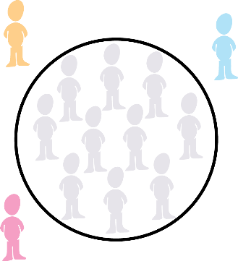
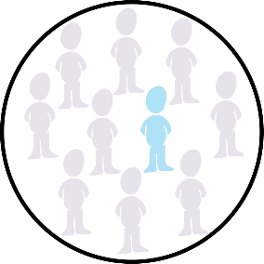
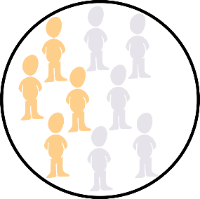
Levels of inclusion
Levels of
Inclusion
Compliance:
individual inclusion
Deliberate:
Inclusion in teams
Systemic: inclusion for all
Exclusion
Notes:
The prevalence rates of Neurodiversity in prisons and unemployment indicate that exclusion is where we still are – disability employment gap remains at 30% (82% employment for abled 52% for disabled)
Compliance is where we respond to individuals in need because we have do. One at a time, disability adjustments, individual level
Deliberate is tokenistic target recruitment (like autism technologists) – group level
Systemic is where inclusion activities are the norm – Universal Design – organizational culture level

Slide 15
1% of long-term unemployed people are dyslexic
1%
of long term unemployed people are dyslexic.
Only 10-15 % of autistic people have a job.
Snowling et al 2010
National Autistic Society, 2016
Notes:
EXCLUSION: 28% of long term unemployed people are dyslexic (10% general population)
10-15% autistic people have a job. (1% general population)

Slide 16
1% of prisoners have ADHD
1%
of prisoners have ADHD.
Source: Young et al., 2018
Notes:
EXCLUSION:
25% of prisoners have ADHD compared to 3-5% in general population

Slide 17



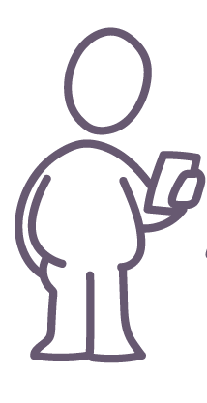
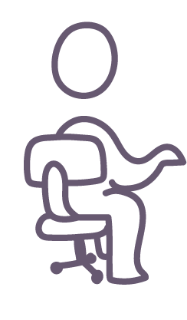
Direct Discrimination
Direct
Discrimination
Making assumptions about capability and treating differently as a result
Failure to make reasonable adjustments
Victimisation or harassment
We are all different – so the best support is individualised
Notes:
Exclusion vs Compliance
You could use an example:
A social worker in a drug rehabilitation project told her manager that she had been assessed as dyslexic. He removed her responsibility for writing reports for the head of Department to help her. She was quite capable of writing reports she just needed to plan carefully and work in a quite area of the office.
A colleague sitting next to a man using Dragon software told him he would never learn to spell if he carried on cheating. He didn’t need to learn how to spell the software did that for him and he wasn’t cheating anymore than someone using a walking aid who had MS would be cheating.
An autistic employee asked to be seated in the corner of the office to be able to reduce the impact of noise, smells and temperature changes from his seat near the coffee station by a stairwell. He was told if he was allowed to move, everyone would ask to move.

Slide 18
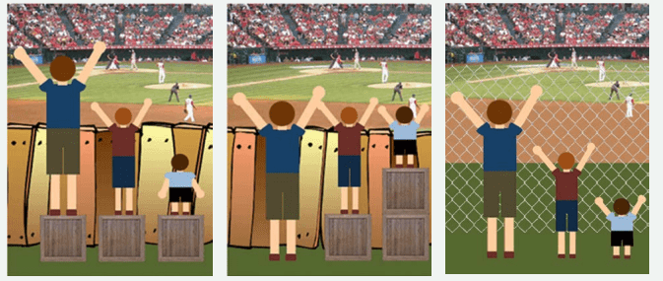
Indirect Discrimination
Indirect
Discrimination
In the first image, it is assume that everyone will benefit from the same supports.
They are being treaded equally.
In the second image, individuals are given different supports to make it possible for them to have equal access to the game.
They are being treaded equitably.
In the third image, all three can see the game without any supports or accommodations because the cause of the inequity was addressed. The systemic barrier has been removed.
Notes:
Exclusion vs compliance
If you give everyone the same adjustment - box to stand on, then some people just wont be able to see over the fence.
If you give some people an individual adjustment – a taller box, some people will see over the fence. - compliance
But if you change the fence, every one will be able to see through, without individual adjustments (Systemic Inclusion – this is where we are aiming but it is not where we are yet!)

Slide 19







Adjustments
Executive Functions Coaching
(memory, concentration, time management, etc)
Schedule flexibility
Supervisor input
(e.g. regular specific feedback,
co-coaching)
Literacy Coaching
Formal training
(in-house or commissioned)
Assistive technology
Workstation adaptations
Environmental flexibility
Source: Doyle 2017 & 2019
Notes:
Adjustments happen at the individual level. They represent compliance with the law.
They are supportive changes that we can make to an individual’s work flow or environment.
Research carried out by Dr Nancy Doyle Genius Within's CEO in using a cohort of over 500 participants recorded that these are the adjustments that support neurodiverse employees most : Which ones do you think were most effective as judged by the participants ?
Executive Functions coaching, Environmental Flexibility and Supervisor Input were the ones that made most difference.
Describe what these may be provided /implement/ put in place.

Slide 20

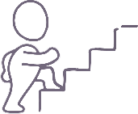

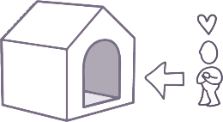
Success Rates
Success Rates
75% self-rated
improvement in performance
47% improvement in productivity (manager rated)
95%
job retention rate
25% promotion rate
Genius Within, 2019.
For more on success of adjustments, see Doyle 2017 & 2019
Notes:
Do adjustments work?
Investing time to listen, support, offer reasonable adjustments or coaching for example can make enormous differences.
Coaching statistics from Genius Within over the past 9 years have continually shown these improvements, and been published following peer review.

Slide 21
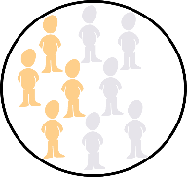

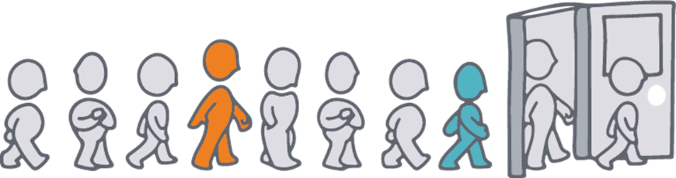




Deliberate inclusion
Notes:
Deliberate inclusion programs?
Discuss tokenism and how the white, male, well-resourced techie has become synonymous with neurodiversity. It’s like hiring only 1 ethnic profile and calling yourself racially diverse.

Slide 22
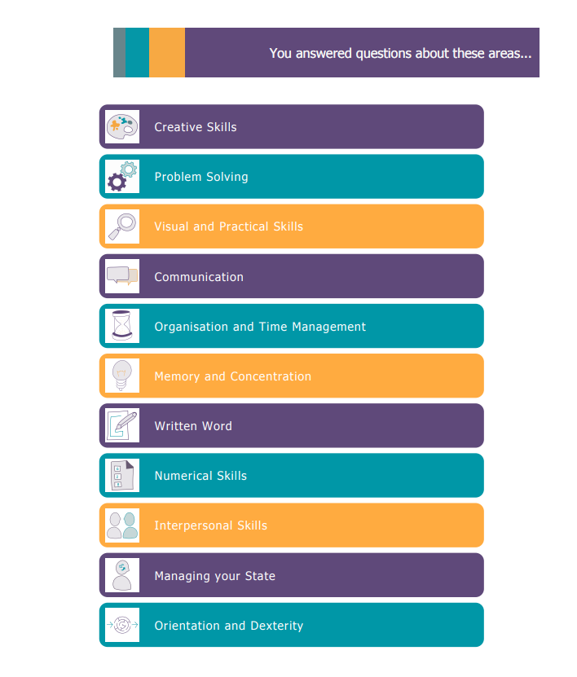
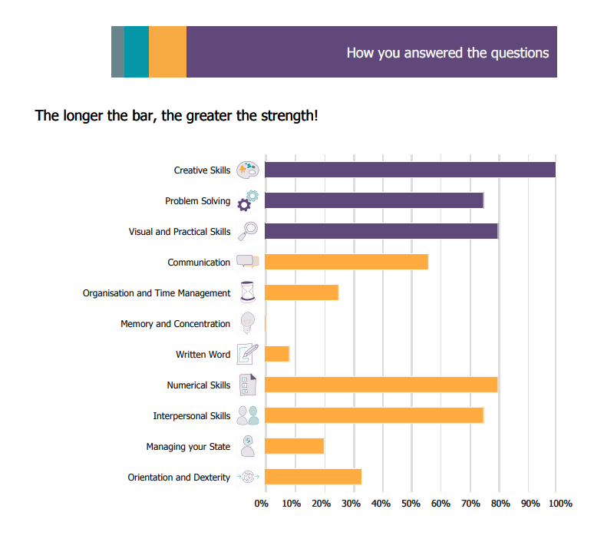
Genius Screener
Genius Screener
Notes:
How can you understand what reasonable adjustments might work well for you?
Genius Screener Link is here: Genius Screener - Genius Within
You are welcome to send out before or after a session

Slide 23
Next Level …
From Awareness to Action
Legal Compliance
NLND Ecosystem
1
2
Enable your organisation to break down preventable barriers by fulfilling legal duties as it should be.
Consider the bigger picture by analysing working conditions, and not just the individual.
Systemic Resolution
NLND Pathway
Avoid individuals being ‘singled out’ by adopting a universal approach to resolve issues found to be common amongst all neurotypes.
Put in place the right adjustments specific to different aspects of the employee experience (e.g. recruitment, onboarding, professional development etc.).
4
3
Notes:
[For inclusion in ND awareness]
What is next for you …
To be universally inclusive, we take a global approach to help organisations make the shift from ‘awareness to action’.
We offer the benefit of multidisciplinary expertise combined with lived experience, enabling organisations to ethically and effectively evolve your business processes.

Slide 24
Systematic Inclusion
Systemic
Inclusion
1
2
0
Working systemically reduces the cost of adjustment by
3
Assumptions
Actions
Results
1%

Slide 25
Commissioning Checklist
Commissioning
checklist
Credentials
Medical vs Social model understanding
Qualifications, regulation, supervision, training
Persecutor
Credentials
Quality Assurance
Evaluation of impact
Try before you buy
Complaints or QA accreditation
Legal
GDPR and data control
Insurance
Governance
Quality
Assurance
Legal
Source: businessdisabilityforum.org.uk
Notes:
This image is draw from a full article that Nancy wrote for the Business Disability Forum along with ACAS
You can find the full article here, How to commission services for supporting neurodiversity at work - Business Disability Forum
You are welcome to share this link

Slide 26








Genius Within
Services
Awareness Training Courses
Profiler and Triage
Next Level Neurodiversity
Intern/Apprentice support
iGenius remote access
Co-coaching Coaching
Strategy 1:1 Coaching
Psychological Assessment
Notes:
Creating standard access to adjustments is essential for systemic inclusion – Next Level rather than only when there is a problem. When commissioning services remember to check:
Credentials and professional expertise
Evidence-based practitioners using feedback and evaluation to confirm the effectiveness of the work
Insurance and financial due diligence
Regulation and complaints process

Slide 27
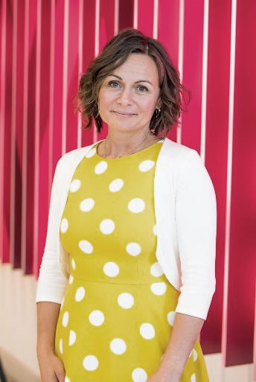
End
“
Inclusion is a moral, social and economic imperative. We all lose when human potential is squandered
”
GeniuswithinCIC
@geniuswithinCIC
Genius Within CIC
@GeniusWithinUK
www.geniuswithin.co.uk | 01273 890 502 | info@geniuswithin.co.uk

